Slide 1
Israel, Jews and Peace
In Palestinian Authority Schoolbooks Used in UNRWA’s Schools
By
Dr. Arnon Groiss
(July 2019)

Slide 2
De-Legitimization of Israel’s Existence

Slide 3
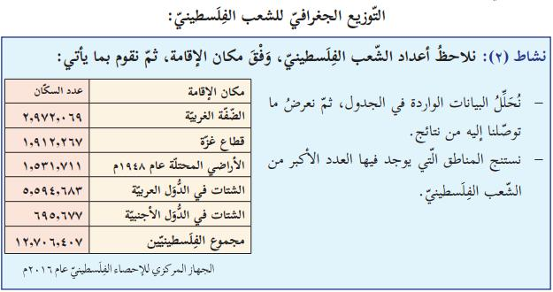
“Geographical Distribution of the Palestinian People
Activity 2: We will look at the figures of the Palestinian people according to domicile and then will do the following:
Domicile Number of Inhabitants
- We will analyze the data appearing in the chart The West Bank 2,972,069 and then present the results we have arrived at. The Gaza Strip 1,912,267
- We will draw conclusions regarding the areas The territories occupied in 1948 1,531,711 where the largest number of [sons] of the The Diaspora in Arab States 5,594,683
Palestinian people reside. The Diaspora in foreign States 695,677
Total number of Palestinians 12,706, 407
Palestinian Central Bureau of Statistics, 2016”
(Geography and Modern and Contemporary History of Palestine, Grade 10, Part 2 (2017) p. 91)

Slide 4
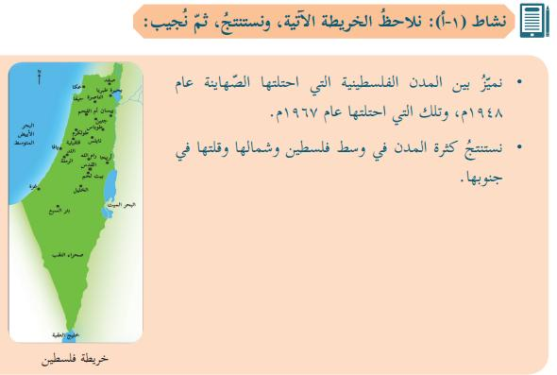
The occupation of Palestine started in 1948:
“Activity 1A: We will look at the following map, draw conclusions and then answer:
- We will distinguish between the Palestinian cities occupied by the Zionists in 1948 and between those one they occupied in 1967.
- …”
(Social Studies, Grade 7, Part 1 (2017) p. 56)

Slide 5
Israel is officially renamed as the “Zionist occupation”:
“…The Rhodes Armistice was signed in 1949 separately between the Zionist Occupation and each of Jordan, Egypt, Syria and Lebanon…”
(Geography and Modern and Contemporary History of Palestine, Grade 10, Part 2 (2017) p. 7)

Slide 6
“Among the statements of the representative of the Occupation State in the United Nations in 1967:”
(Geography and Modern and Contemporary History of Palestine, Grade 10, Part 2 (2017) p. 41)

Slide 7

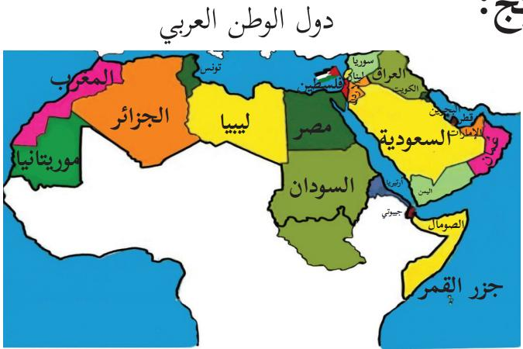
“2. Palestine is Arab [and] Muslim”
“States of the Arab Homeland”
“Palestine”
(National and Social Upbringing, Grade 4, Part 1 (2017) p. 7)

Slide 8
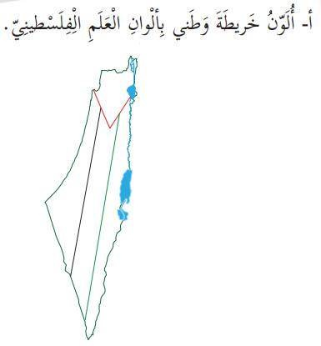
“A. I will color the map of my homeland with the colors of the Palestinian flag.”
(National and Life Education, Grade 2, Part 1 (2017) p. 8)

Slide 9
“Palestine is located in the Asian wing of the Arab homeland, within the region known as the Levant [Bilad al-Sham in Arabic] that includes the states of Palestine, Jordan, Syria and Lebanon. Palestine is located in the south-western part of the Levant.”
(Geography and Modern and Contemporary History of Palestine, Grade 10, Part 1 (2017) p. 7)

Slide 10
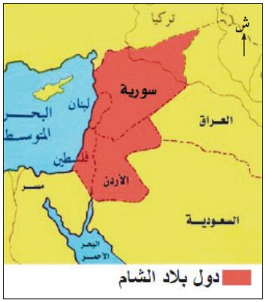
“States of the Levant”
“Syria”, “Lebanon:, Jordan”, “Palestine”
(Social Studies, Grade 6, Part 1 (2017) p. 42)

Slide 11
De-Legitimization of the Jews’ Presence in the Country in the Past and at Present

Slide 12

A piece omparing the Jews in Israel to the European colonialists in America:
“Let us think and discuss:
I will compare the tragedy of the red-skinned Indians, the original inhabitants of America, and the tragedy of the Palestinian people.”
(Social Studies, Grade 8, Part 2 (2017) p. 33)

Slide 13
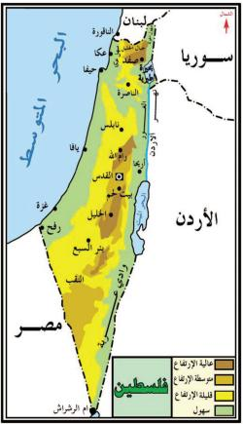
Map of Palestine without the Jewish cities, including Tel Aviv. Eilat is referred to as Umm al-Rashrash
“Palestine”
“Umm al-Rashrash”
(Social Studies, Grade 5, Part 2 (2017) p. 40)

Slide 14
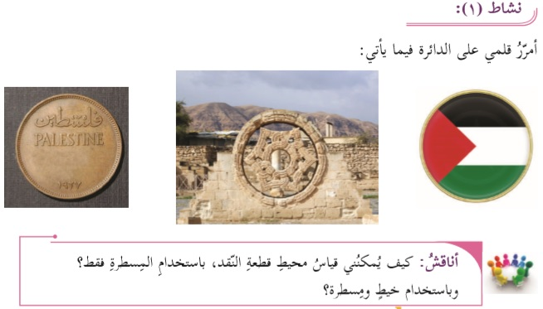
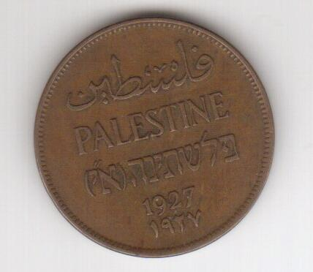
The Hebrew inscription is erased from a British Mandatory coin
(Mathematics, Grade 6, Part 2 (2017) p. 63)
And see the original coin on the left

Slide 15
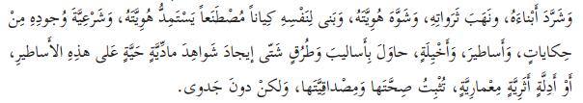
Denial of Jewish history in the country:
“…[The occupier] constructed for himself an artificial entity that derives its identity and the legitimacy of its existence from stories, legends and fantasies. He tried in various methods and ways to create material living evidence for these legends, or archeological and architectural indications that would prove its truth and substantiality, but in vain.”
(Arabic Language – The Academic Path, Grade 10, Part 2 (2017) p. 71)

Slide 16

“Jerusalem is an Arab city built by our Arab ancestors thousands of years ago.
Jerusalem is a holy city among Muslims and Christians.”
(National and Social Upbringing, Grade 3, Part 1 (2017) p. 28)

Slide 17
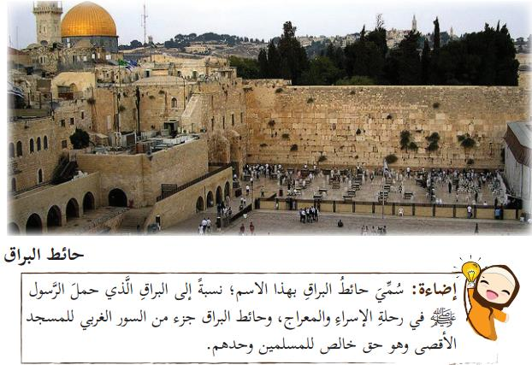
The Wailing Wall is presented as an exclusively Muslim holy place:
“The Al-Buraq Wall [the Western Wall]
Illumination:
The Al-Buraq Wall has been thus named after [the divine beast] Al-Buraq that carried the Messenger [of God, i.e., Muhammad] in the Nocturnal Journey [from Mecca to Jerusalem according to Muslim belief]. The Al-Buraq Wall is part of the western wall of Al-Aqsa Mosque and it is an absolute right of the Muslims alone.”
(Islamic Education, Grade 5, Part 1 (2017) p. 54)

Slide 18
Demonization of Israel

Slide 19

“The soldiers attack the children out of fear of their dreams.”
(Arabic Language, Grade 9, Part 2 (2017) p. 58)

Slide 20
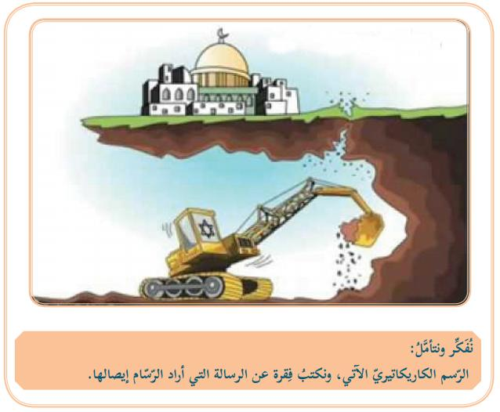
An Israeli tractor underneath the Temple Mount mosque:
“Let us think and look attentively at the following cartoon and write a paragraph about the message that the cartoonist wanted to convey.”
(Social Studies, Grade 7, Part 1 (2017) p. 64)

Slide 21

“…And [the Zionist occupation] set loose herds of wild boars that caused damage to the [Palestinian] inhabitants and their crops…”
(Social Studies, Grade 9, Part 1 (2017) p. 21)

Slide 22
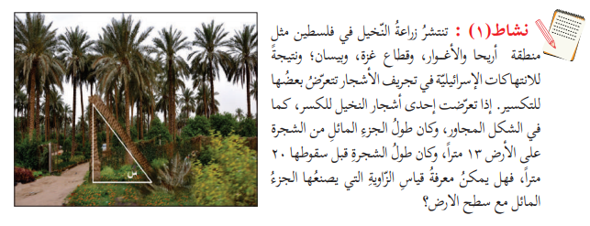
A question in geometry:
“Activity 1: Date palm growing is widespread in Palestine, like the region of Jericho and the Jordan Valley, the Gaza Strip and Beisan [Israeli Beit Shean]. As a result of the Israeli abuses of tree removal, some of them become broken. If one of the date palm trees was broken – as is the case in the adjacent picture, and the length of the bent part of the tree downward 13 meters, and the length of the tree before it was broken had been 20 meters, is it possible to know the measure of the angle made by the bent part with the land surface?”
(Mathematics, Grade 9, Part 2 (2017) p. 8)

Slide 23
Demonization of Jews

Slide 24

“1. The Zionists based their entity on terror, extermination and colonization. Let us explain that.”
(Arab Language – The Academic Path, Grade 10, Part 2 (2017) p. 27)

Slide 25

“Let us watch a video clip from the attached disk about the Jews’ attempt to kill God’s Messenger [Muhammad].”
(Islamic Education, Grade 5, Part 2 (2017) p. 65)

Slide 26

“Where are the horsemen [who would ride] towards Al-Aqsa [Mosque] to liberate it
From the grip of unbelief, from the Devil’s aides?”
(Arab Language, Grade 7, Part 1 (2017) p. 66)

Slide 27
Violent Struggle for Liberation instead of Peace Education

Slide 28
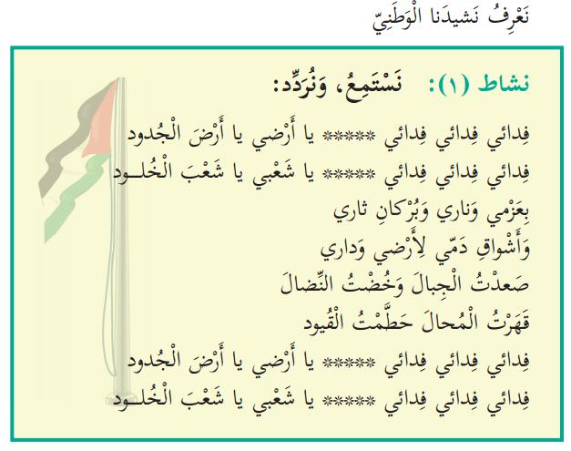
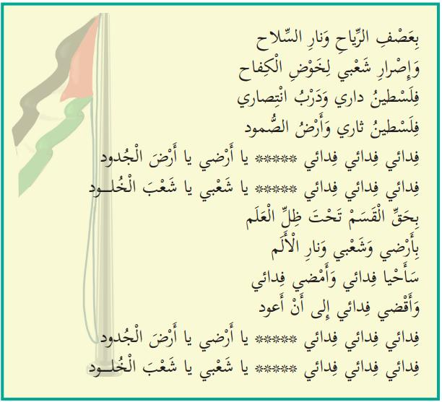
The PA national anthem titled Fidai:
Fidai, fidai, fidai, O my land, O land of the forefathers
Fidai, fidai, fidai, O my people, O people of eternity
With my determination, my fire and the volcano of my revenge [tha'r]
And my blood's yearning to my land and my home
I have climbed mountains and went into struggle
I defeated the impossible and shattered the shackles
Fidai, Fidai, Fidai, O my land, O land of the forefathers
Fidai, fidai, fidai, O my people, O people of eternity
In the winds' storm and the weapon's fire
And my people's determination to carry on the struggle
Palestine is my home and the road to my victory
Palestine is my revenge [tha'ri] and the land of steadfastness
Fidai, Fidai, Fidai, O my land, O land of the forefathers
Fidai, Fidai, Fidai, O my people, O people of eternity
By the oath under the flag's shadow
By my people's determination, and by the pain's fire
I shall live as a Fidai and I shall continue as a Fidai
And I shall die as a Fidai until I return
Fidai, fidai, fidai, O my land, O land of the forefathers
Fidai, fidai, fidai, O my people, O people of eternity“
(National and Social Upbringing, Grade 3, Part 1 (2017) pp. 15-16)

Slide 29
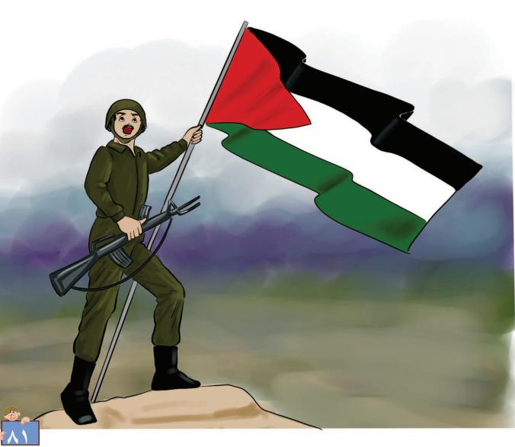
The violent liberation struggle as presented to first-grade students:
(Our beautiful Language, Grade 1, Part 2 (2017) p. 81)

Slide 30
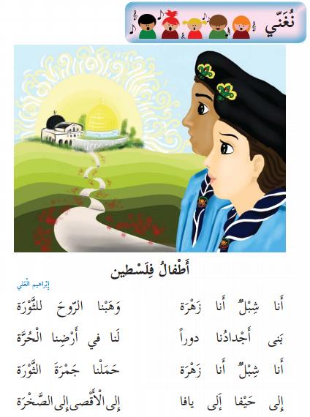
Haifa and Jaffa are to be liberated too:
"Let us sing:
I am a lion cub; I am a flower; we gave the soul to the revolution
Our forefathers built for us houses in our [formerly] free country
I am a lion cub; I am a flower; we carried the revolution's ember
To Haifa, to Jaffa, to Al-Aqsa [Mosque], to the [Dome of the] Rock“
(Our Beautiful Language, Grade 2, Part 1 (2017) p. 42)
“Lion cub” - a term denoting male members of the al-Fatah youth movement.
“Flower” - a term denoting a female member of that movement.
“Revolution” - a term denoting the activity of the Palestinian al-Fatah organization that started in January 1965, that is, before the occupation of the West Bank and the Gaza Strip by Israel in 1967.

Slide 31

"It would be appropriate for Jaffa to return to us.“
(Arabic Language, Grade 8, Part 2 (2017) p. 101)

Slide 32
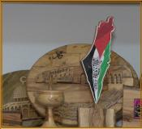
There is no place for Israel in free Palestine:
“Free Palestine”
(Science and Life, Grade 3, Part 1 (2017) p. 65)

Slide 33
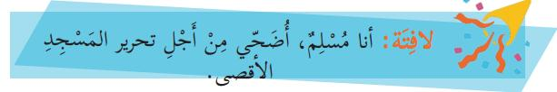
The religious aspect of the struggle:
“I am a Muslim. I make sacrifices for the sake of the liberation of Al-Aqsa Mosque.”
(Islamic Education, Grade 5, Part 1 (2017) p. 56)

Slide 34
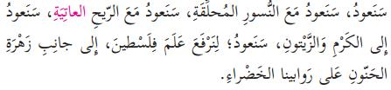
The return of the refugees to liberated Palestine, not to Israel:
“We shall return. We shall return with the soaring vultures. We shall return with the strongly blowing wind. We shall return to the vineyard and the olive trees. We shall return to raise the flag of Palestine, next to the anemone flower, on our green hills.”
(Arabic Language, Grade 5, Part 1 (2017) p. 82)

Slide 35
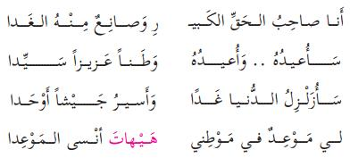
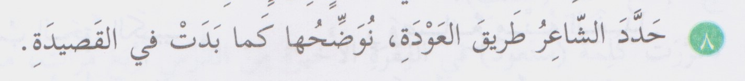
"…I am the owner of the great right, from which I create the morrow
I shall reclaim it; I shall reclaim it as a precious and sovereign homeland
I shall shake the world tomorrow and march as a consolidated army
I have an appointment with my homeland and it is impossible that I forget that appointment“
“[Question] 8: The poet defined the way of the return. We will clarify it as it appears in the poem.”
(Arabic Language, Grade 5, Part 1 (2017) pp. 85, 86, respectively)

Slide 36

This theme is clearly emphasized at the end of one of the stories:
“…Is he not crazy, the one who is driven out of his homeland and then is ready to return to it as a guest with the robbers who had seized it?“
(Arabic Language, Grade 10, Part 1 (2017) p. 57)

Slide 37
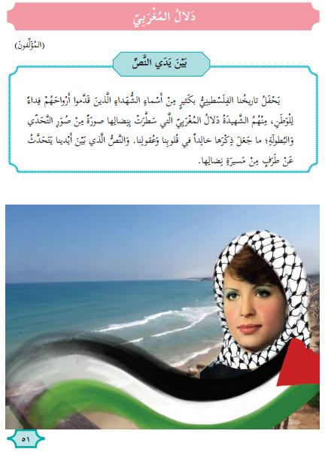
The beginning of a 4-page chapter about the head of the terrorist attack on an Israeli civilian bus in 1978:
"Dalal al-Mughrabi
([By] the authors [of the textbook])
In front of the text:
Our Palestinian history is full of many names of martyrs who presented their souls as a sacrifice for the homeland. Among them is the martyr Dalal al-Mughrabi who painted with her struggle a picture of challenge and heroism that have made her memory eternal in our hearts and minds. The text in front of us provides a glance on the path of her struggle.“
(Arabic Language, Grade 5, Part 2 (2017) p. 51)

Slide 38

"The neighbor: 'The curfew does not include us in Al-Sharafah [neighborhood]. It is imposed on Al-Natarish [neighborhood]. It seems that there is a barbecue party [haflat shiwaa'] there with Molotov cocktails on one of the buses of the Psagot colony [musta'marah - Jewish settlement] on Mount Al-Tawil“
(Arabic Language’ Grade 9, Part 1 (2017) p. 16. the expression “barbecue Party” is marked in red.)

Slide 39
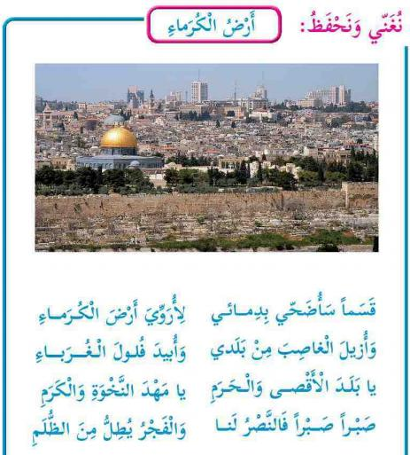
The total extermination of Israel’s Jews is hinted:
“Let us sing and learn by heart: The Nobles’ Land
I have sworn, I shall sacrifice my blood
To water the nobles’ land
And to remove the usurper [code name for Israel]
And to exterminate the foreigners’ scattered remnants
O land of Al-Aqsa [Mosque] and the holy sanctuary
O cradle of pride and nobility
Patience, patience, for victory is ours
And dawn peeps out from darkness.”
(Our Beautiful Language, Grade 3, Part 2 (2017) p. 64)

