Slide 1
Israel, Jews and Peace in the Palestinian Authority’s
Schoolbooks and Teachers’ Guides by
Dr. Arnon Groiss
(March 2020)

Slide 2

“The teacher will tell [the students] a short story about our homeland Palestine: ‘My grandfather was living in a beautiful village in [the vicinity of] Haifa. He worked in agriculture, loved the land and guarded it. On one sad day, foreign faces came to expel my grandfather from his land, burn the crop and force him to emigrate to distant lands’.”
(Teacher’s guide, Our Beautiful Language, Grade 2 (2018) p. 124)

Slide 3
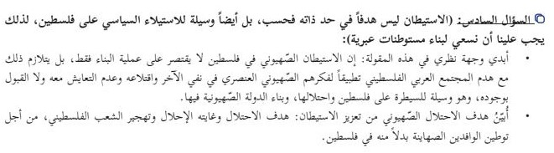
“Sixth question: ‘Settlement is not a goal in itself only, but it is also a means to seizing control of Palestine politically. Therefore, we must built Hebrew settlements’:
I will express my opinion on this saying: Zionist settlement in Palestine is not restricted to construction activity only, but accompanies the destruction of the Palestinian Arab society, thus implementing their racist Zionist thinking of denying the other and its uprooting, no coexistence with it and unacceptance of its existence. It is a means for controlling Palestine and its occupation and the building of the Zionist state there.
I will explain the Zionist occupation’s goal in strengthening the settlement: The occupation’s goal is to replace and force the Palestinian people to emigrate in order to make the Zionist immigrants settle in Palestine instead.”
(Answers to questions: teacher’s guide, History Studies, Grade 11 (2018) p. 126)

Slide 4
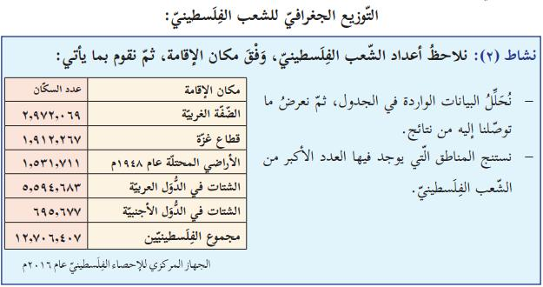
“Geographical Distribution of the Palestinian People:
Activity 2: Let us look at the figures of the Palestinian people according to places of residence and then we will do the following:
-Analyze the data appearing in the chart and then present the results we have reached.
-Draw conclusions regarding the regions where the largest numbers of the Palestinian people are found.
Place of Residence Number of Inhabitants
The West Bank 2,972,069
The Gaza Strip 1,912,267
The territories occupied in 1948 1,531,711
The diaspora in the Arab states 5,594,683
The diaspora in the foreign states 695,677
The Palestinians’ total number 12,706, 407
The Central Bureau for Palestinian Statistics, 2016”
(Geography and Modern and Contemporary History of Palestine, Grade 10, Part 2 (2019) p. 92. Emphasis Added)

Slide 5
“…The Arab armies withdrew from Palestine and the Rhodes armistice was signed in 1949 separately between the Zionist occupation and each of Jordan, Egypt, Syria and Lebanon...”
(Geography and Modern and Contemporary History of Palestine, Grade 10, Part 2 (2019) p. 7)

Slide 6
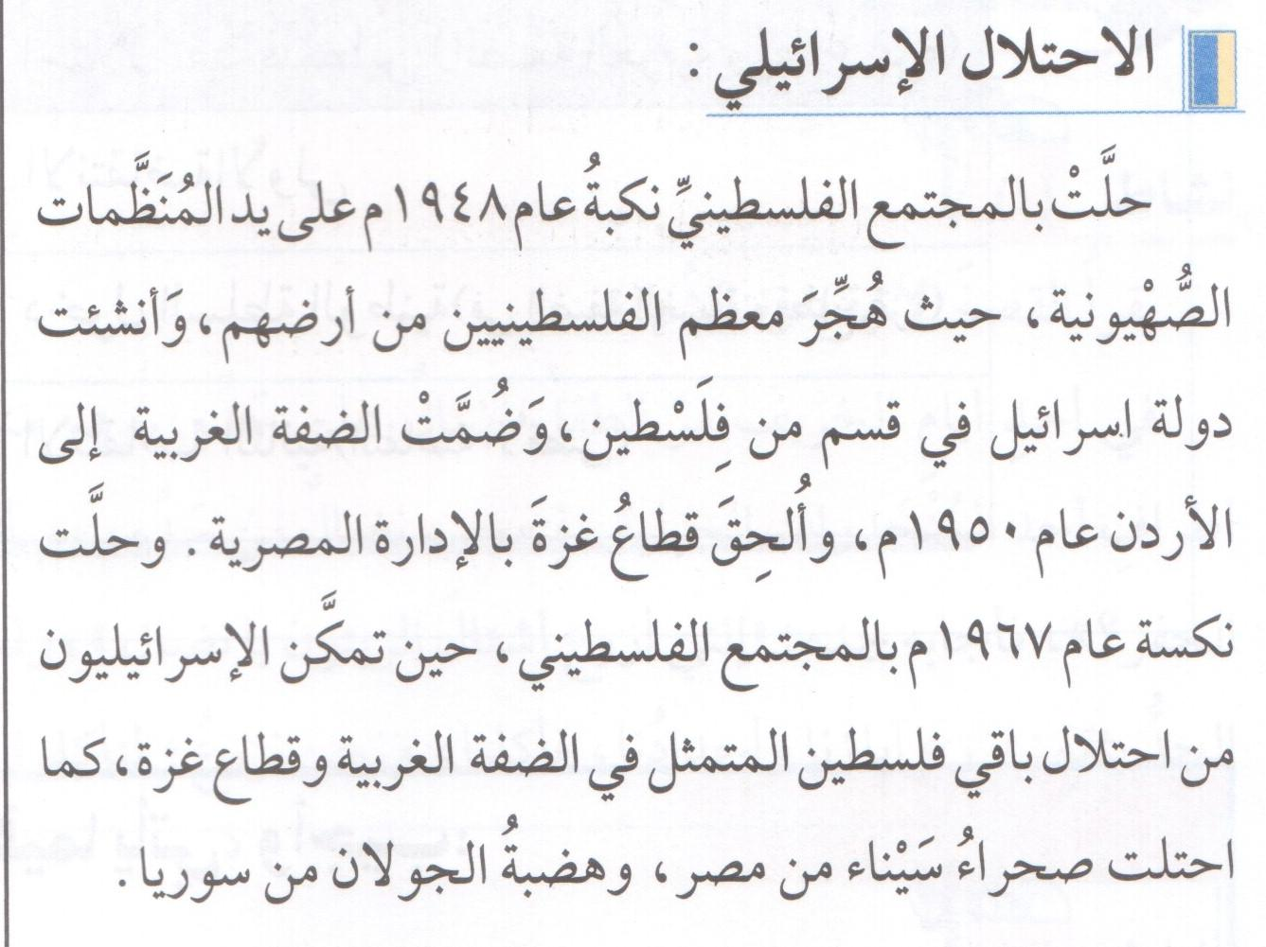
“The Israeli Occupation
The Catastrophe [Nakbah] of 1948 was inflicted on the Palestinian society by the Zionist organizations, as most of the Palestinians were forced to emigrate from their land and the State of Israel was established in part of Palestine. The West Bank was annexed to Jordan in 1950 and the Gaza Strip was attached to the Egyptian administration. The setback [Naksah] of 1967 fell on the Palestinian society, as the Israelis managed to occupy the reminder of Palestine, that is, the West Bank and the Gaza Strip. The Sinai desert was also occupied from Egypt and the Golan Heights from Syria.”
(National Education, Grade 5 (2014) p. 30. Emphasis Added)

Slide 7

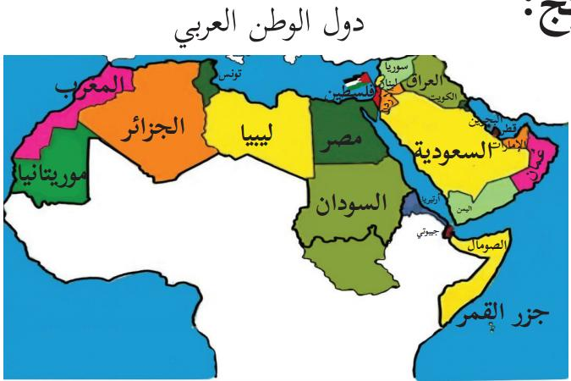
“Palestine is Arab and Muslim”
“States of the Arab Homeland”
“Palestine”
(National and Social Upbringing, Grade 4, Part 1 (2019) p. 8)

Slide 8
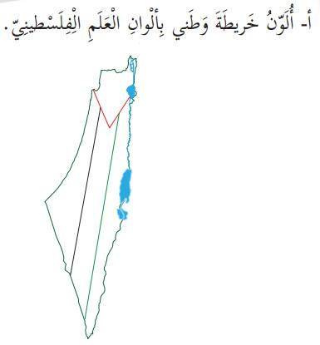
“A. I will color the map of my homeland with the colors of the Palestinian flag”
(National and Life Education, Grade 2, Part 1 (2019) p. 8)

Slide 9
“Palestine is located in the Asian wing of the Arab homeland, in a region known as the Levant [Bilad al-Sham in Arabic] which includes the states of Palestine, Jordan, Syria and Lebanon, and Palestine is located in the south-western part of the Levant.”
(Geography and Modern and Contemporary History of Palestine, Grade 10, Part 1 (2019) p. 7)

Slide 10
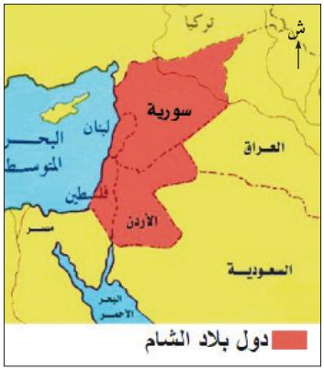
“States of the Levant”
“Syria”, “Lebanon”, “Jordan”, “Palestine”
(Social Studies, Grade 6, Part 1 (2019) p. 43)

Slide 11
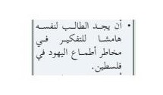
“The student will find for himself free time to reflect on the dangers of the Jews’ greedy ambitions [atma’] in Palestine.”
(Assignment: Teacher’s guide, Arabic Language, Grade 9 (2018) p. 30)

Slide 12
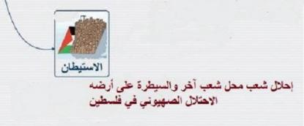
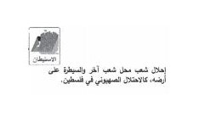
“Colonization [istitan]: Replacement of a people by another people and seizing control over its land – the Zionist occupation of Palestine.”
(History Studies, Grade 11, Part 1 (2017) p. 9) (History Studies, Grade 11, Part 1 (2019) p. 9)

Slide 13

“I will compare the tragedy of the Indians, America’s original inhabitants, to the tragedy of the Palestinian people.”
(Social Studies, Grade 8, Part 2 (2019) p. 34)

Slide 14
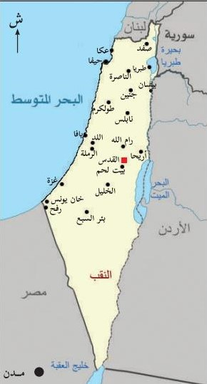
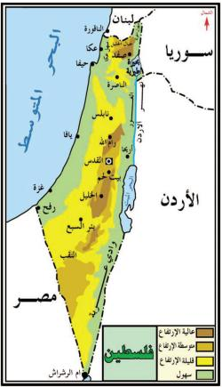
“Palestine”
“Umm al-Rashrash”
(Social Studies, Grade 6, Part 1 (2019) p. 57) (Social Studies, Grade 5, Part 2 (2019) p. 36)

Slide 15
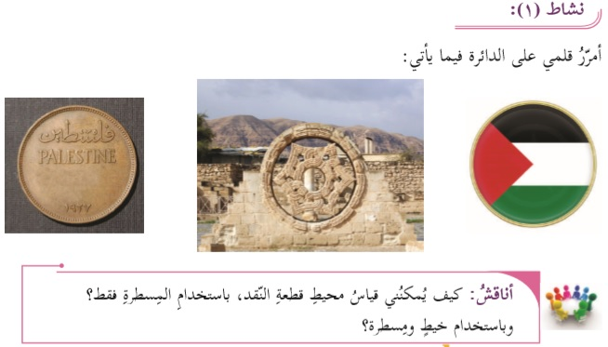
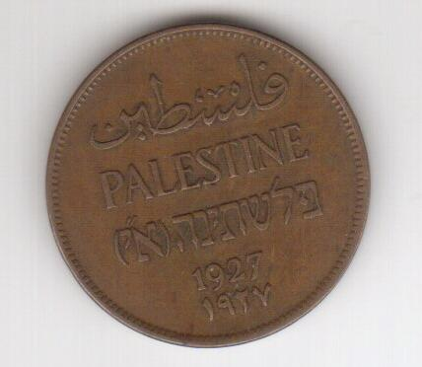
(Mathematics, Grade 6, Part 2 (2019) p. 75)

Slide 16
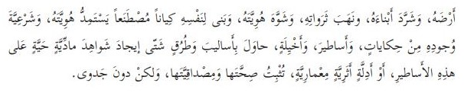
“…[The occupier] has built for himself an artificial entity that derives its identity and the legitimacy for its existence from tales, legends and false visions, and tried in various methods and ways to create live material evidence for these legends, or archaeological and architectural proofs that would confirm their truth and substantiality, but in vain.”
(Arabic Language – Academic Path, Grade 10, Part 2 (2019) p. 68)

Slide 17
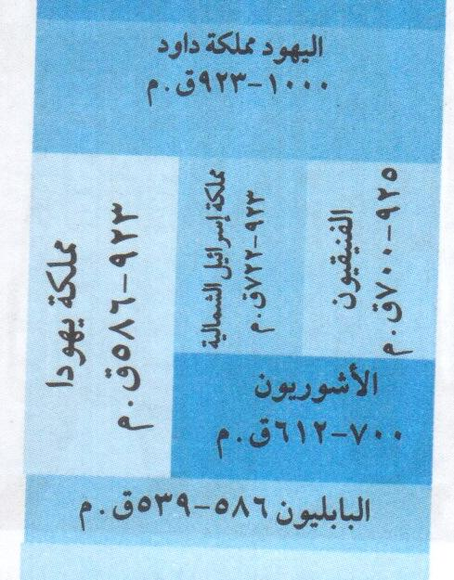
“The Jews – David’s kingdom
1000 – 923 BC
Kingdom Northern kingdom The Phoenicians of Israel of 923 - 722 BC 925 – 700 BC
Judea The Assyrians 700 – 612 BC
923 – 586 BC
The Babylonians 586 – 539 BC”
(National Education, Grade 7 (2013) p. 3. A similar chart with identical items also appears in History of the Middle Ages, Grade 7 (2014) p. 74)

Slide 18

“Jerusalem is an Arab city built by our Arab ancestors thousands of years ago.
Jerusalem is a holy city to Muslims and Christians.”
(National and Social Upbringing, Grade 3, Part 1 (2019) p. 29)

Slide 19


“Even if the enemies dig in its history false [archaeological] excavations and baseless claims and build on its soil a forged heritage and a reality supported by force and tyranny…”
“…so that it [Jerusalem] will remain in the nation’s consciousness sacred, high above the misery of the fait accompli, the distorted narratives, the usurped histories and the grip of the invaders who do not save efforts in falsifying history, marketing illusions and letting loose the tools of destruction so that they would distort geography.”
(Arabic Language 1: Reading, Grammar, Prosody and Expression – Academic Path, Grade 12 (2019) pp. 39, 40)

Slide 20
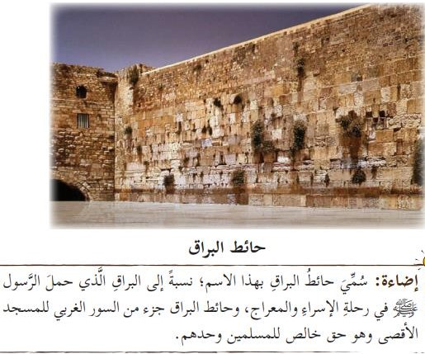
“Al-Buraq Wall”
“Illumination: Al-Buraq Wall is thus named after Al-Buraq [the divine beast] that carried [according to Islamic belief] the Messenger [Muhammad] in the Isra’ and Mi’raj Journey [nocturnal journey from Mecca to Jerusalem, from which he ascended to Heaven having tied Al-Buraq to the Wailing Wall]. The Al-Buraq Wall is part of the western wall of Al-Aqsa Mosque and it is the exclusive right of the Muslims alone.”
(Islamic Education, Grade 5, Part 1 (2019) p. 63)

Slide 21
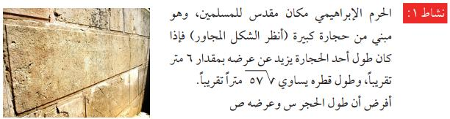
“The sacred place of Abraham [Al-Haram al-Ibrahimi – the Cave of the Patriarchs] is a holy place to Muslims…”
(Mathematics, Grade 11, part 2 [Sciences] (2019) p. 97)

Slide 22
“Activity 1: In that quiet and peaceful village, whose inhabitants were dreaming of their [daily] bread, and which is found at Jerusalem’s outskirts, at that spring day’s morning, when the people were still sleeping, the gangs of violence, oppression and slyness entered the village, killed close to three hundred peaceful [inhabitants] and expelled its people in order to empty the land of its inhabitants and seize control of their lands.
About what village does the text talk?”
(Mathematics, Grade 11, Part 1 [Sciences] (2019) p. 68)

Slide 23

“4. The soldiers attack the children out of fear of their dreams.”
(Arabic Language, Grade 9, Part 2 (2019) p. 60)

Slide 24
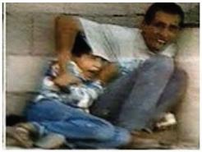
The Palestinian boy Muhammad al-Durrah, who, according to a French TV film, was killed by Israeli fire, appears as an example alongside questions in biology regarding neural impact on physical reactions in the human body under various circumstances.
(Biology, Grade 11, Part 1 [Sciences] (2018) p. 77)

Slide 25

“3. One of the settlers shoots at [Palestinian] cars that pass on one of the roads. If the probability of his hitting a car in one shot is 0.7, and the settler shot at 10 cars, what will you expect to be the number of cars that were hit?”
(Mathematics, Grade 11 [Humanities] (2018) p. 55. In the teacher’s guide for this class, from the same year, the answer appears on p. 162: 7)

Slide 26
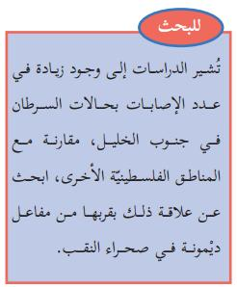
“For research:
Studies show an increase in cases of cancer in southern Hebron, comparing to other Palestinian areas. I will research the connection of that to its location near the Dimona [nuclear] reactor in the [Israeli] Negev desert.”
(Scientific Education, Grade 11 (2017) p. 40)

Slide 27

“[The occupation]… let loose herds of wild boars that caused damage to the [Palestinian] inhabitants and their crops.
(Social Studies, Grade 9, Part 1 (2019) p. 19. The item is marked in red within the text.)

Slide 28

“[The martyrs] carried [their] hearts on [their] palms like a stone, an amber, a burning fire
And threw them at the highway’s wild beast.
…
[Assignment:] 1. We will explain the description of the occupying enemy given by the poetess.”
(Arabic Language 1, Grade 11, Part 1 (2019) pp. 74, 76, respectively)

Slide 29

“The Zionist occupation spreads its venom in all corners of life in Palestine.”
(Teacher’s guide, Arabic Language, Grade 8 (2018) p. 121)

Slide 30

“Activity 2: Drawing a picture that would embody the massacre: Divide the students into non-homogenic groups and each group will be required to imagine the events of the massacre, draw them and paint them with the appropriate colors. The pictures will be posted in a visible place in class. Some of the pictures will be chosen for discussion.”
(teacher’s guide, Arabic Language, Grade 7 (2018) p. 153)

Slide 31



The text: “These gangs spread destruction in the city and dug their fangs of hostility in its pure body.”
The question: “5. We will clarify the beauty of the description: ‘They dug their fangs of hostility in its pure body’.”
(Teacher’s guide, Arabic Language, Grade 9 (2018) p. 193)
The answer: “[The writer] likened the Zionist gangs to a beast of prey and the city of Safad to the prey on which it pounces and digs its fangs in its body.”
(Teacher’s guide, Arabic Language, Grade 9 (2018) p. 150)

Slide 32

“Each student will be requested to describe his feelings vis-à-vis the occupation’s crimes against the Palestinian children.”
(Teacher’s guide, Arabic Language, Grade 9 (2018) p. 106)

Slide 33
“…or due to the strengthening of the racist spirit, especially when a certain group thinks that it is the best race on earth, or [due to] carrying out of colonialist projects of control over a land and [its] inhabitants, like the Zionist colonialist Imperialism [al-isti’mar al-istitani] in Palestine.”
(History Studies, Grade 12 [Humanities] (2019) p. 5, and see the question on p. 6 regarding the basic motive for “the Zionist aggressions against the Palestinian people.”)

Slide 34

“1. The Zionists based their entity on terror, extermination [ibadah] and colonialism [isti’mar]. We will explain that.”
(Arabic Language – Academic Path, Grade 10, Part 2 (2019) p. 28)

Slide 35

“The Jews perpetrated war crimes against our people incessantly.”
(teacher’s guide, Arabic Language, Grade 9 (2018) p. 150)

Slide 36
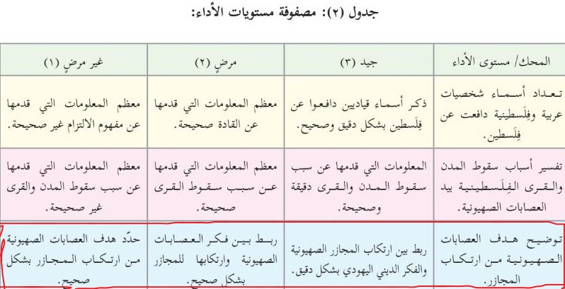
“Clarification of the Zionist gangs’ goals in perpetrating massacres:
Good (3): [The student] connected accurately the perpetration of the Zionist massacres to the Jewish religious thinking.
Satisfactory (2): [The student] connected accurately the thinking of the Zionist gangs to their perpetration of massacres.
Unsatisfactory (1): [The student] defined accurately the Zionist gangs’ goals of perpetrating massacres [but did not connect that to the Jewish or Zionist thinking!]”
(Teacher’s guide, Geography and Modern and Contemporary History of Palestine, Grade 10 (2018) p. 164)

Slide 37
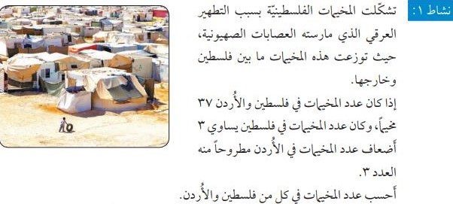
“The Palestinian refugee camps were formed because of the ethnic cleansing perpetrated by the Zionist gangs. These camps are spread inside and outside Palestine. If the number of the refugee camps in Palestine and Jordan is 37, and the number of the camps in Palestine is three folds the number of the camps in Jordan minus 3 – I will calculate the number of the camps in each of Palestine and Jordan.”
(Mathematics, Grade 11 [Humanities] (2018) p. 7)

Slide 38

“Spreading corruption on earth is of the Children of Israel’s nature.”
(Holy Qur’an and its Sciences, Grade 11 [Shar’i stream] (2013) p. 149)

Slide 39

“Let us watch the video clip from the attached disc about the Jews’ attempt to kill God’s Messenger [Muhammad].”
(Islamic Education, Grade 5, Part 2 (2019) p. 65)

Slide 40

“Where are the horsemen [who would ride] to Al-Aqsa [Mosque] to liberate it from the grip of infidelity, from the Devil’s aides?”
(Arabic Language, Grade 7, Part 1 (2019) p. 67)

Slide 41
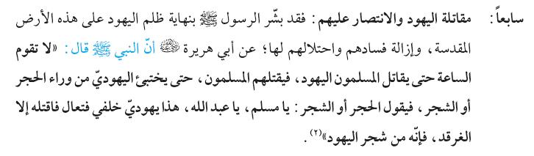
“…7. The fighting against the Jews and the victory over them: The Messenger [Muhammad] announced [the good news of] the end of the Jews’ oppression in this holy land and the removal of their corruption and their occupation there. [It was related] by Abu Hurayrah [one of Prophet Muhammad’s companions] that the Prophet had said: ‘The End of Days shall not come until the Muslims fight the Jews and the Muslims will kill them, and even if a Jew would hide behind a rock or a tree, the rock or the tree would say: ‘O Muslim, O God’s servant, there is a Jew [hiding] behind me, so come and kill him’, except the salt bush, for it is [one] of the Jews’ trees’.”
(Faith, Grade 11 [Shar’i stream] (2013) p. 94)

Slide 42
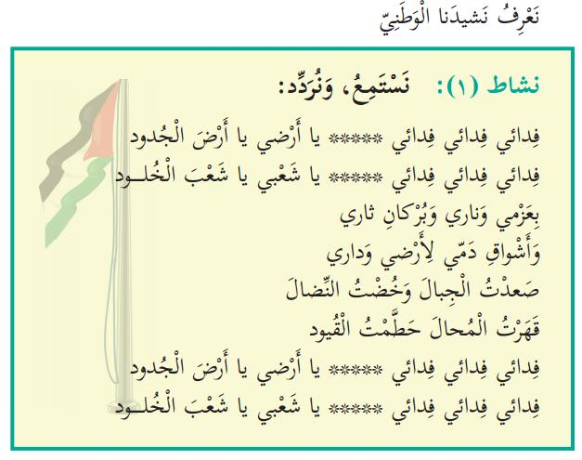
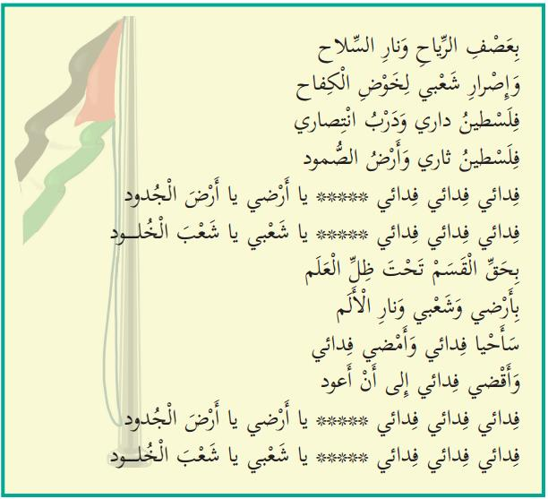
“Fidai, fidai, fidai, O my land, O land of the forefathers
Fidai, fidai, fidai, O my people, O people of eternity
With my determination, my fire and the volcano of my revenge [tha'r]
And my blood's yearning for my land and my home
I have climbed mountains and went into struggle
I defeated the impossible and shattered the shackles
Fidai, Fidai, Fidai, O my land, O land of the forefathers
Fidai, fidai, fidai, O my people, O people of eternity
In the winds' storm and the weapon's fire
And my people's determination to carry on the struggle
Palestine is my home and the road to my victory
Palestine is my revenge [tha'ri] and the land of steadfastness
Fidai, Fidai, Fidai, O my land, O land of the forefathers
Fidai, Fidai, Fidai, O my people, O people of eternity
By the oath under the flag's shadow
By my land and my people, and by the pain's fire
I shall live as a Fidai and I shall continue as a Fidai
And I shall die as a Fidai until I return
Fidai, fidai, fidai, O my land, O land of the forefathers
Fidai, fidai, fidai, O my people, O people of eternity“
(National and Social Upbringing, Grade 3, Part 1 (2019) pp. 16-17. Emphases added)

Slide 43
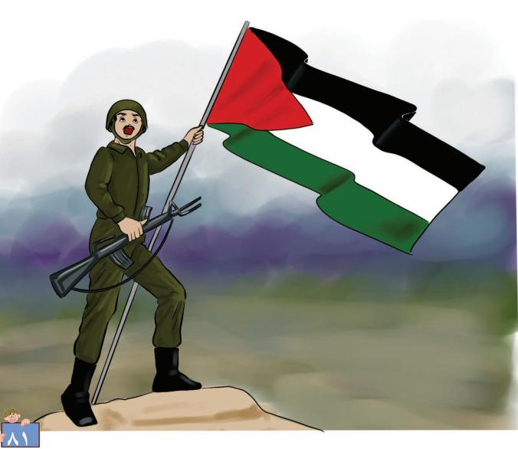
(Our Beautiful Language, Grade 1, Part 2 (2019) p. 83)

Slide 44
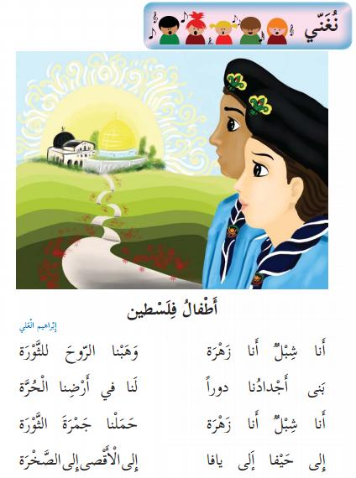
“Let us sing:
Children of Palestine
I am a lion cub; I am a flower;
We gave the soul to the Revolution
Our forefathers built houses
For us in our free land [in the past].
I am a lion cub; I am a flower;
We carried the Revolution's ember
To Haifa, to Jaffa,
To Al-Aqsa, to the [Dome of the] Rock”
(Our Beautiful Language, Grade 2, Part 1 (2019) p. 44)
(Lion cub: Male member of Al-Fatah’s youth movement
Flower: Female member of that movement
Revolution: Al-Fatah’s terrorist activity that began in January 1965)

Slide 45

“It would be appropriate for Jaffa to return to our bosom.”
(Arabic Language, Grade 8, Part 2 (2019) p. 102)

Slide 46
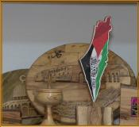
“Free Palestine”
(Sciences and Life, Grade 3, Part 1 (2019) p. 65)

Slide 47
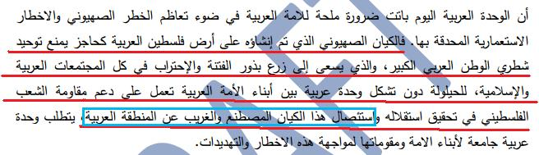
“…The Zionist entity, which was established on the land of Arab Palestine as a barrier preventing the unification of the grate Arab homeland’s two parts, and which aspires to spreading the seeds of civil strife in all Arab and Muslim societies in order to prevent the formation of Arab unity among the sons of the Arab nation that would work for the support of the Palestinian people’s resistance for achieving its Independence and for uprooting this artificial and foreign entity from the Arab region…”
(History Studies, Grade 12, Draft (No date [2018] p. 145. The emphasized part has been deleted and replaced by the word “goals”.)

Slide 48

“Poster: I am a Muslim; I sacrifice for the sake of the liberation of Al-Aqsa Mosque.”
(Islamic Education, Grade 5, Part 1 (2019) p. 65)

Slide 49



“Expected difficulties and the mechanism of their treatment:
The Expected Difficulties The Suggested Solutions
Some of the students do not know the qualities Encouragement of research, either by
given by God to the martyrs exclusively. resorting to the Internet or to reference
books, or to the teacher of Islamic Education,
in order to become familiar with the status of
the martyr and what is given to him exclusively
by God out of respect to him and to his family.”
(Teacher’s guide, Arabic Language 1, Grade 11 (2018) p. 74)

Slide 50
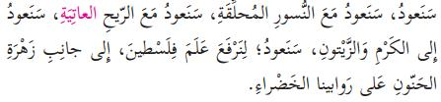
“We shall return; we shall return with the soaring eagles; we shall return with the wildly blowing wind; we shall return to the vineyards and the olive trees; we shall return in order to raise the flag of Palestine, alongside the anemone flower, on our green hills.”
(Arabic Language, Grade 5, Part 1 (2019) p. 84)

Slide 51
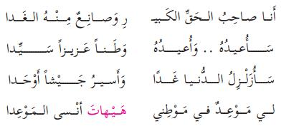
“I am the owner of the great right from which I will make the future
I shall reclaim it; I shall reclaim it as a precious and sovereign homeland
I shall shake the world tomorrow and shall march as a unified army
I have an appointment with my homeland and it is impossible for me to forget the appointment.”
(Arabic Language, Grade 5, Part 1 (2019) p. 86, and see among the accompanying questions: “The poet determined the form of the return. Let us clarify it as it appears in the poem.”)

Slide 52

“I am crazy indeed. Is the one expelled from one’s homeland and than agrees to return to it as a guest among the robbers who had taken ownership over it, not crazy indeed?”
(Arabic Language, Grade 10, Part 1 (2019) p. 58)

Slide 53

“[The student] will shout the expression ‘we shall definitely return!’ said by Layla to the butterflies.”
(Assignment, teacher’s guide, Our Beautiful Language, Grade 4 (2018) p. 41)

Slide 54
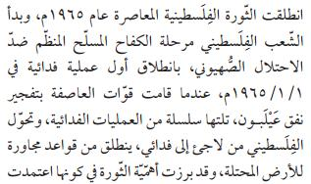
“The contemporary Palestinian revolution erupted in 1965 and the Palestinian people started the phase of the organized armed struggle against the Zionist occupation with the first self-sacrificing operation [amaliyyah fida’iyyah – a term referring to a terrorist action in Palestinian parlance] on 1.1.1965, when Al-Asifah forces [the military wing of Al-Fatah movement] blew up the Eylabun Tunnel [of the National Water Carrier – the operation failed] and a series of [additional] self-sacrificing operations followed suit. The Palestinian [individual] was transformed from a refugee to a fidai [self-sacrificing person – a term denoting a member of the Palestinian armed organizations]…”
(History Studies, Grade 11, Part 2 (2019) p. 51)

Slide 55

“…The Palestinian organizations reacted [to Israel’s attacks against them in Lebanon] with several operations against Zionist targets, including aircraft hijacking operations…”
(Geography and Modern and Contemporary History of Palestine, Grade 10, Part 2 (2019) p. 61)

Slide 56

“The Palestinian Resistance resorted to many methods in its resistance to the Zionist occupation. The fidais [members of Palestinian armed organizations] used the guerrilla method in most of their confrontations with the Zionists inside the Palestinian territories. They also resorted to hitting the Zionist interests abroad, like the Munich operation [against Israeli athletes in the Olympic Games] in 1972 and the direct confrontation in many battles, such as the battle of Karameh [in Jordan] in 1968.”
(History Studies, Grade 11, Part 2 (2019) p. 52. Emphasis added.)

Slide 57
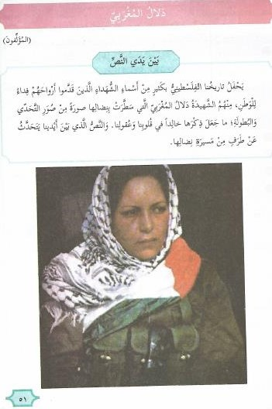
“Dalal al-Mughrabi
[By] the authors [of the schoolbook]
In front of the text:
Our Palestinian history is full of many names of martyrs who gave their souls as a sacrifice for the homeland. Among them [was] the female martyr Dalal al-Mughrabi who painted with her struggle a picture of challenging and heroism which have made her memory eternal in our hearts and minds. The text in front of us talks about an aspect of her struggle path.”
(Arabic Language, Grade 5, Part 2 (2019) p. 51)

Slide 58
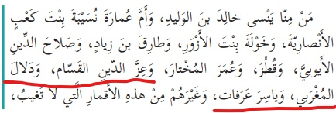


A piece talking of Arab and Muslim heroes in history, including “Izz al-Din al-Qassam, Dalal al-Mughrabi and Yasser Arafat” (Marked in red).
(Arabic Language, Grade 5, Part 1 (2019) p. 15)
Assignment: “2. We will name two Palestinian heroes mentioned in the text.”
(Arabic Language, Grade 5, Part 1 (2019) p. 16)
The answer in the teacher’s guide:
“2. Yasser Arafat, Dalal al-Mughrabi”
(Teacher’s guide, Arabic Language, Grade 5 (2018) p. 191)

Slide 59
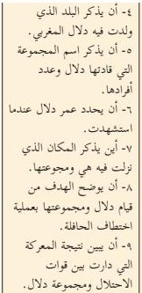
Some goals of the lesson about Dalal al-Mughrabi:
“4. [The student should] mention the place where Dalal al-Mughrabi was born.
5. Mention the name of the group commanded by Dalal and the number of its members.
6. Give Dalal’s age when she fell as a martyr.
7. Mention the place where she and her group members landed.
8. Clarify the goal of the commandeering operation of the bus by Dalal and her group.
9. Give the result of the battle that took place between the occupation forces and Dalal’s group.
(Teacher’s guide, Arabic Language, Grade 5 (2018) p. 110)

Slide 60
“Some states and their communication media regard the actions taken by the national liberation movements as terrorist actions. In the Palestinian case, the Zionist occupation, and some states that support it regard the Palestinian people’s struggle to liberate its homeland as a terrorist activity that should be resisted and eliminated by all means. On the other hand, you will find many other states that regard the resistance of the Palestinian people as legitimate and as a legal right approved by the international community and the international laws.
…
An issue for discussion: Some people interpret the resistance actions carried out by the liberation movements as terrorist actions. How would you answer that?”
(History Studies, Grade 11, Part 2 (2019) p. 12)

Slide 61
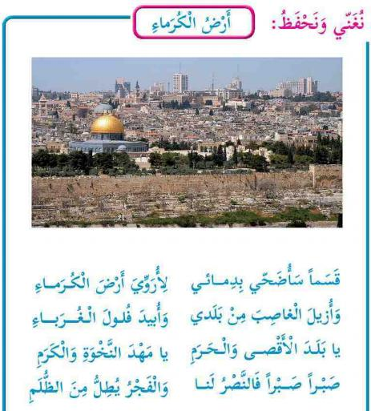
“We will sing and learn by heart:
The Land of the Noble Ones
I swear! I shall sacrifice my blood
In order to water the land of the noble ones
And to remove the usurper [Ghaseb - Israel] from my land
And to exterminate [ubid] the foreigners’ remnants
O land of Al-Aqsa [Mosque] and the holy place [haram]
O cradle of pride and nobility
Patience, patience, for victory is ours
And dawn is peeping from the darkness”
(Our Beautiful Language, Grade 3, Part 2 (2019) p. 66)

Slide 62
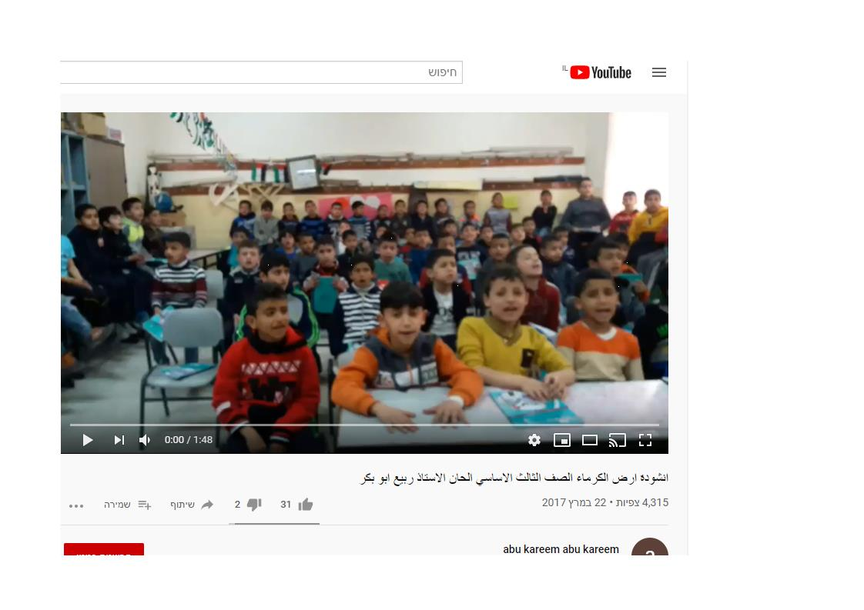

“The student will sing the poem ‘The Land of the Noble Ones’ in [its] melody.”
(Teacher’s guide, Our Beautiful Language, Grade 3 (2018) p. 56)
https://www.youtube.com/watch?v=Yan7tf3E6UU

Slide 63

“The neighbor: ‘The curfew does not include us in al-Shurafah [neighborhood]. It is imposed on al-Natarish [neighborhood]. It seems that there is a barbecue party there with Molotov Cocktails on one of the buses of Psagot colony [musta’marah] on Mount al-Tawil.”
(Arabic Language, Grade 9, Part 1 (2019) p, 61. The “barbecue party” expression is marked in red)

