Slide 1
Anti-Semitism in UNRWA Education In the West Bank, East Jerusalem and Gaza
By
Dr. Arnon Groiss
(February 2021)

Slide 2
The United Nations Relief and Works Agency (UNRWA) provides the descendants of the Palestine 1948 refugees with educational services in Syria, Lebanon, Jordan, the West Bank, East Jerusalem and Gaza. In the last three regions it is responsible for the education of about 25% of the Palestinian school students in grades 1-10, that is, over 320,000 students in some 370 schools.

Slide 3
UNRWA chose from the very start of its operation, some 70 years ago, to use in its schools textbooks used by the host governments. In the West Bank, East Jerusalem and Gaza it uses schoolbooks provided by the Palestinian Authority (PA).

Slide 4
That raises a serious ethical problem, since these books delegitimize the existence of the State of Israel – a full member state of the UN – and the very presence of its Jewish citizens in the country, severely demonize both Israel and the Jews, and advocate the liberation of Palestine in its entirety – including Israel’s pre-1967 territories – by a violent struggle, instead of a peaceful resolution of the conflict, as decreed by UN resolutions.

Slide 5
Being a UN agency, UNRWA is committed to neutrality and peace, but the use of such schoolbooks sharply contradicts that commitment. Moreover, these books also contain anti-Semitic expressions, which makes UNRWA a full accomplice of the PA anti-Semitic indoctrination.

Slide 6
Anti-Semitism in Palestinian schoolbooks is expressed in two ways: A. Jews are presented as enemies of Islam, which makes the war against them a religious obligation. B. Jews are demonized in the context of the present conflict. Following are some examples:

Slide 7
The Religious Context

Slide 8
Presenting the Jews of Arabia as enemies of Prophet Muhammad and Islam, with attributed traits such as treachery and hostility, is part and parcel of their demonization today: “But the Jews [in the city of Medina] did not respect the treaty [they had concluded with Muhammad] and resorted to all sorts of treachery, betrayal and hostility, which forced the Muslims to fight them.” (Islamic Education, Grade 7, Part 1 (2020) p. 52)

Slide 9
One of the accusations against them is their attempts to assassinate the Prophet of Islam: “A subject for discussion: The Jews’ recurrent attempts to kill the Prophet [Muhammad]” (Assignment, Islamic Education, Grade 5, Part 2 (2019) p. 66)

Slide 10
UNRWA’s Education even includes a video clip about this issue: “Let us watch the video clip from the attached CD about the Jews’ attempt to kill God’s Messenger [Muhammad]” (Islamic Education, Grade 5, Part 2 (2019) p. 65)

Slide 11
Jewish intrigues and conspiracies in a language exercise: “The Jews’ intrigues and conspiracies were the immediate reasons for the [Jewish fortress] Khaybar expedition.” (Islamic Education, Grade 9, Part 1 (2020) p. 62)

Slide 12
The first out of several lessons related to a story about Jesus Christ (who is considered one of God’s prophets in Islam) presents the Jews as enemies of all God’s prophets: “1. Revealing the Children of Israel’s nature and their hostility to the prophets.” (Islamic Education, Grade 9, Part 2 (2019) p. 21)

Slide 13
In the Context of the Current Conflict

Slide 14
One out of several false accusations against the Jews: “A subject for discussion: The desecration by the Jews of the tombs of some of the revered Companions [of Prophet Muhammad] and the pious ones, their sweeping away and removal from the Muslim graveyards in Jerusalem particularly and in Palestine generally.” (Islamic Education, Grade 5, Part 2 (2019) p. 71)

Slide 15
A verse of a poem taught in school in which the Jews are described as infidels and the Devil’s aides: “Where are the horsemen [who will ride] to liberate Al-Aqsa [Mosque] From the grip of infidelity, from the Devil’s aides?” (Arabic Language, Grade 7, Part 1 (2020) p. 67)

Slide 16
Another false accusation, against Zionists this time – genocidal intentions towards Palestinians: “The Zionists established their entity [i.e., Israel] on terror, extermination and colonialism. We will elaborate on that.” (Assignment, Arabic Language – Academic Path, Grade 10, Part 2 (2019) p. 28)

Slide 17
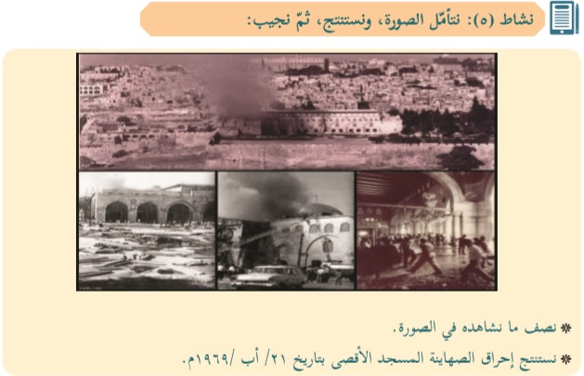
And another false accusation against Zionists: “Activity 5: We will look at the picture, draw conclusions and then answer: [Pictures] * We will describe what we see in the picture. * We will draw conclusions regarding the burning of Al-Aqsa Mosque by the Zionists on August 21, 1969.” (Social Studies, Grade 7, Part 2 (2019) p. 49) *The arsonist was a Christian Australian tourist named Michael Denis Rohan who was found to be insane and duly hospitalized in Israel and, later, in Australia.

Slide 18
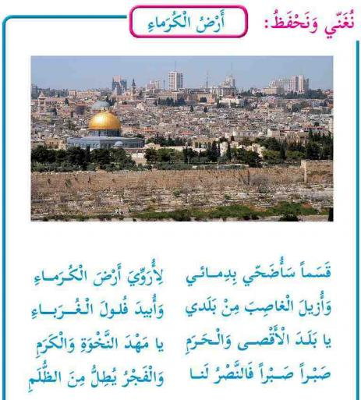
A verse in a poem sung by third graders in class which answers the question: What should be done with the Jews who will survive the war of liberation (in bold): “We will sing and learn by heart: The Land of the Noble Ones I swear! I shall sacrifice my blood In order to water the land of the noble ones And to remove the usurper from my country And to exterminate the foreigners’ remnants O country of Al-Aqsa and the Sanctuary O cradle of pride and nobility Patience, patience, for victory is ours And dawn is peeping out from the darkness” (Our Beautiful Language, Grade 3, Part 2 (2019) p. 66)

Slide 19
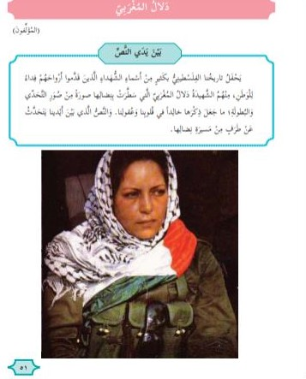
Terror is part and parcel of the liberation struggle. This is the first page of a lesson about a leader of a terrorist group that attacked an Israeli civilian bus in 1978 and murdered close to 40 of its passengers, including 13 children: “Dalal al-Mughrabi In front of the text Our Palestinian history is full of names of the martyrs who sacrificed their souls for the homeland. One of them is the martyr Dalal al-Mughrabi who has drawn with her struggle a picture of challenging and heroism, which has made her memory eternal in our hearts and minds. The text in front of us tells an aspect of the path of her struggle.” (Arabic Language, Grade 5, Part 2 (2019) p. 51)

