Slide 1
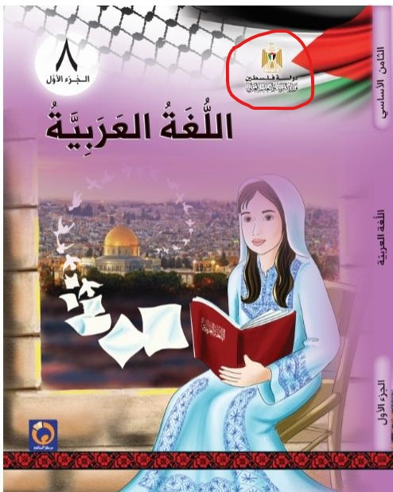
The Palestinian Authority describes itself as “the State of Palestine” and considers itself a full state under foreign occupation the boundaries of which are not restricted to the 1967 lines. The name “the State of Palestine”, not “the Palestinian Authority”, appears on the cover of all schoolbooks. The example here – the cover of an Arabic language textbook for grade 8, part 1, published in 2020 – shows the PA emblem with the inscription underneath saying “the State of Palestine; Ministry of Education and Higher Education” (marked by a red circle on top right).

Slide 2
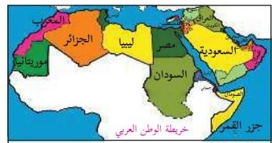
“[Lesson] 2: Palestine is Arab and Muslim” The lesson presents a map titled “Map of the Arab Homeland” in which the whole country is painted red with the name “Palestine” appears next to it and the Palestinian flag is drawn above. (National and Social Upbringing, Grade 4, part 1 (2020) p. 8)

Slide 3
A map titled “Map of Palestine and the Levant” in which Palestine appears as a sovereign state, instead of the State of Israel, next to Lebanon, Syria and Jordan. (Geography and Modern and Contemporary History of Palestine, Grade 10, Part 1 (2020) p. 8)

Slide 4
The term “Zionist occupation” usually replaces the name “Israel” in the schoolbooks”: “…The Arab armies withdrew from Palestine and the Rhodes Armistice was signed in 1949 separately between the Zionist occupation and each of Jordan, Egypt, Syria and Lebanon…” (Geography and Modern and Contemporary History of Palestine, Grade 10, Part 1 (2020) p. 7)

Slide 5
The term “the territories occupied in 1948” replaces in the schoolbooks the expression “Israeli territory”: “The following chart clarifies the numbers of Palestinians in the year 2015 according to the Palestinian Statistics Center: Region Number of Inhabitants The West Bank and the Gaza Strip 4,750,000 Inside the territories occupied in 1948 1,470,000 In the Arab states 5,460,000 In the foreign states 685,000 I will organize the regions where the Palestinians are found in a descending order according to the numbers of inhabitants: [4 empty squares]” (Mathematics, Grade 4, Part 1 (2020) p. 22. Emphasis added)

Slide 6
Israel and its inhabitants are considered a foreign colonialist entity: “I will compare the tragedy of the Indians, America’s original inhabitants, to the tragedy of the Palestinian people.” (Social Studies, Grade 8, Part 2 (2019) p. 34)

Slide 7
Denial of the country’s Jewish history: “…[The occupier] has built for himself an artificial entity that derives its identity and the legitimacy of its existence from fairy rales, legends and phantasies and tried in various methods and ways to create living material evidence for these legends, or archaeological [and] architectural proofs that would attest to their correctness and authenticity, but in vain.” (Arabic Language – the Academic Path, Grade 10, Part 2 (2019) p. 68)

Slide 8
Denial of the existence of Jewish holy places in the country, including the Wailing Wall in Jerusalem (note that the photograph is cut in a way that “hides” the Jews who pray there): “Al-Buraq Wall lllumination: The Al-Buraq Wall is thus named after Al-Buraq [the divine beast] that carried the Messenger [Muhammad] in the Nocturnal Journey [from the Mecca mosque to Al-Aqsa Mosque in Jerusalem according to Muslim belief]. Al-Buraq Wall is part of the western wall of Al-Aqsa Mosque. Al-Aqsa Mosque, including the wall, is a Palestinian land and the Muslims’ exclusive right.” (Islamic Education, Grade 5, Part 1 (2020) p. 63)

Slide 9
Having been considered foreign settlers, the Jews in the country are not counted among the country’s inhabitants and the cities they built, including Tel Aviv, are absent from the maps featured in textbooks that are used in UNRWA schools. The map shown here, titled “Map of Palestine”, does not show these cities at all, except for Eilat that appears under the Arabic name of the desolate place where it was later built – “Umm al-Rashrash”. (Social Studies, Grade 6, Part 1 (2020) p. 6)

Slide 10
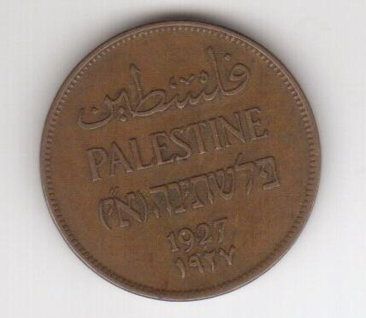
Hebrew – the language of the Jews in the country – is erased, literally, from a British Mandate coin reproduced in a mathematics textbook: (Mathematics, Grade 6, Part 2 (2019) p. 75, and see the original coin on the left)

Slide 11
The Jews’ historical and religious ties to Jerusalem are completely ignored: “Jerusalem is an Arab city built by our Arab ancestors thousands of years ago. Jerusalem is a holy city for Muslims and Christians.” (National and Social Upbringing, Grade 3, Part 1 (2020) p. 29)

Slide 12
A short description of Jerusalem’s history with a huge gap between the Jebusites and the Romans, namely, the Jewish historical period: “The city of Jerusalem was known by the name Jebus, after the Arab Jebusites who built it 5,000 years ago. When the Romans occupied it, they called by the name Aelia. Later, it came to be known as Al-Quds and Bayt al-Maqdis, after the Muslims conquered it at the hands of [Caliph] Umar Bin al-Khattab in the year 637…” (Geography and Modern and Contemporary History of Palestine, Grade 10, Part 1 (2020) p. 43)

Slide 13
Demonization of Israel by way of self-victimization. Following are excerpts from “a Letter by a Palestinian girl to children of the world”:
“Since I was born, they have murdered my childhood. They tore my doll into pieces and I have hidden it in my heart. Since I was born, the bullets whistle has pierced my ears and blackness has covered everything around me…
…Why did they slaughter my childhood in front of me and murder the roses in the fields? Why did they kill the butterflies in our gardens and scare the birds away? Why did they hide the sun, spread darkness and blocked the roads?”
(Arabic Language, Grade 8, Part 1 (2020) pp. 47, 48, respectively)

Slide 14
Zionists are demonized and accused of genocidal intentions towards the Palestinians: “1. The Zionists have founded their entity on terror, extermination and colonialism. Let us explain that.” (Arabic Language – Academic Path, Grade 10, Part 2 (2019) p. 28)

Slide 15
Jews are demonized as enemies of Islam from its very beginning: “Let us watch the video clip from the accompanied disc about the Jews’ attempt to kill God’s Messenger [Muhammad].” (Islamic Education, Grade 5, Part 2 (2019) p. 65)

Slide 16
Jews are demonized as infidels and as the Devil’s aides: “Where are the horsemen [who will ride] to Al-Aqsa [Mosque] to liberate it From the grip of infidelity, from the Devil’s aides?” (Arabic Language, Grade 7, Part 1 (2020) p. 67)

Slide 17
The only reference in the schoolbooks to the issue of peace with Israel is found in Arafat’s letter to Rabin prior to the signing of the Oslo Accords in 1993 given in a history textbook, without any further advocacy: “…The Palestine Liberation Organization recognizes the State of Israel’s right to live in peace and security. The Organization accepts the UN Security Council’s resolutions Nos. 242 and 338. The Organization commits itself to the peace process in the Middle East and to the peaceful resolution of the conflict between the two parties and declares that all the political issues related to the permanent situation will be solved through negotiations. Accordingly, the Organization denounces the use of terror and other violent actions…” (Geography and Modern and Contemporary History of Palestine, Grade 10, Part 2 (2019) p. 77, and see the full letter below:)

Slide 18
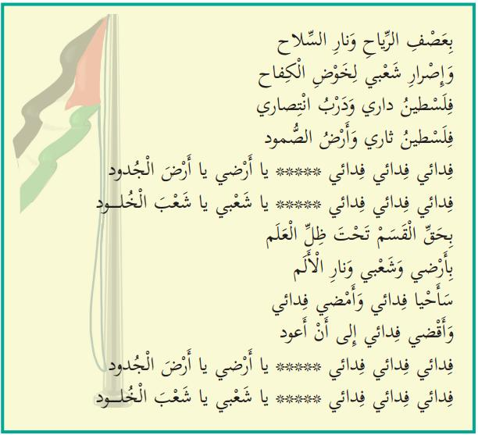
Expressions of violence in the Palestinian Authority’s national anthem taught in school:
"Let us know our national anthem:
Activity 1: We will listen and repeat:
Fidai*, fidai, fidai, O my land, O land of the forefathers
Fidai, fidai, fidai, O my people, O people of eternity
With my determination, my fire and the volcano of my revenge
And my blood's yearning to my land and my home
I have climbed mountains and embarked on a struggle
I defeated the impossible and shattered the shackles
Fidai, Fidai, Fidai, O my land, O land of the forefathers
Fidai, fidai, fidai, O my people, O people of eternity
In the winds' storm and the weapon's fire
And my people's determination to carry on the struggle
Palestine is my home and the road to my victory
Palestine is my revenge and the land of steadfastness
Fidai, Fidai, Fidai, O my land, O land of the forefathers
Fidai, Fidai, Fidai, O my people, O people of eternity
By the oath under the flag's shadow
By my people's determination, and by the pain's fire
I shall live as a Fidai and I shall continue as a Fidai
And I shall die as a Fidai until I return
Fidai, fidai, fidai, O my land, O land of the forefathers
Fidai, fidai, fidai, O my people, O people of eternity“
(National and Social Upbringing, Grade 3, Part 1 (2020) pp. 16-17. Emphasis added)
*Fidai – a self-sacrificing person; this term is used nowadays to denote the members of the Palestinian terrorist organizations.

Slide 19
The liberation struggle as depicted to grade 1 students: (Our Beautiful Language, Grade 1, Part 2 (2019) p. 83)

Slide 20
The liberation of Palestine does not end at the 1967 lines. Haifa and Jaffa are included too: “Let us sing: Children of Palestine I am a lion cub*; I am a flower** We have given the soul to the Revolution*** Our forefathers built houses For us in our free country [in the past] I am a lion cub; I am a flower We have carried the ember of the Revolution To Haifa, to Jaffa to Al-Aqsa [Mosque], to the [Dome of the] Rock” *Lion cub – Male member of the Fatah youth movement **Flower – Female member of that movement ***Revolution – Fatah terrorist activity that began on 1.1.1965 (Our Beautiful Language, Grade 2, Part 1 (2020) p. 44)

Slide 21
Jaffa is considered a Palestinian occupied city that should be liberated, as said in a language exercise: “It is appropriate for Jaffa that it return to our bosom.” (Arabic Language, Grade 8, Part 2 (2019) p. 102)

Slide 22
There is no room for Israel in free Palestine: "Free Palestine" (Sciences and Life, Grade 3, Part 1 (2020) p. 65)

Slide 23
The ending of a story about a refugee’s reminiscences emphasizes that the return of the 1948 refugees will be an integral part of the full liberation of Palestine: “We shall return; we shall return with the soaring eagles; we shall return with the fiercely blowing wind; we shall return to the vineyard and the olive trees; we shall return in order to hoist the flag of Palestine next to the anemone flower on our green hills.” (Arabic Language, Grade 5, Part 1 (2020) p. 84)

Slide 24
Part of a poem titled “A Refugee’s Cry” stresses the same point: “I am the owner of the great right and the one who makes the morrow out of it I shall retrieve it; I shall retrieve it as a precious and sovereign homeland I shall shake the world tomorrow and shall march as one army I have an appointment in my homeland and it is impossible that I forget the appointment” (Arabic Language, Grade 5, Part 1 (2020) p. 86, and see among the accompanying questions: “The poet has determined the form of the return. Let us clarify it, as it appears in the poem.”)

Slide 25
Terror is part and parcel of the liberation struggle. Following is the first page of a 4-page lesson that exalts the female commander of the terrorist attack on a civilian bus on Israel’s Coastal Highway in 1978 in which more than thirty Israelis – men, women and children were murdered: “Dalal al-Mughrabi In front of the text Our Palestinian history is replete with many names of martyrs who have given their soul in sacrifice for the homeland. Among them [is] the martyr Dalal al-Mughrabi who has illustrated with her struggle a picture of challenging and bravery that have made her memory eternal in our hearts and minds. The text in front of us speaks of one aspect of her struggle path.” (Arabic Language, Grade 5, Part 2 (2019) p. 51)

Slide 26
A rare explicit reference to the question: what should be done with the surviving Jews after the liberation of Palestine? “We will sing and learn by heart: The Land of the Noble Ones I swear, I shall sacrifice my blood in order to water the land of the noble ones And to remove the usurper [Israel] from my country and to exterminate the foreigners’ [defeated] remnants O land of Al-Aqsa [Mosque] and the sanctuary O cradle of dignity and nobleness Patience, patience, for victory is ours and dawn is peeping from the darkness (Our Beautiful Language, Grade 3, Part 2 (2019) p. 66. Emphasis added)

