Slide 1
War Indoctrination in Palestinian Authority Schoolbooks Used by UNRWA
By
Dr. Arnon Groiss
(August 2021)

Slide 2
Peace?

Slide 3
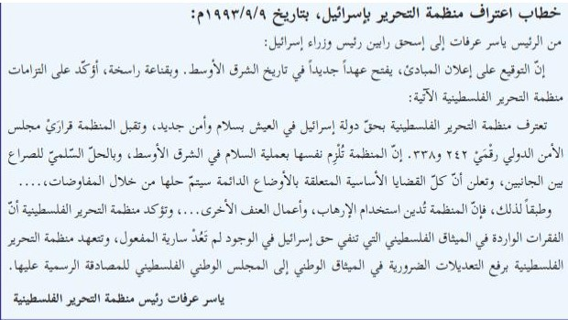
The only reference in the schoolbooks to the issue of peace with Israel is found in Arafat’s letter to Rabin prior to the signing of the Oslo Accords in 1993, given in a history textbook. But peace and co-existence with Israel is never advocated in any schoolbook throughout the entire curriculum. Following are the relevant excerpts from Arafat’s letter: “…The Palestine Liberation Organization recognizes the State of Israel’s right to live in peace and security. The Organization accepts the UN Security Council’s resolutions Nos. 242 and 338. The Organization commits itself to the peace process in the Middle East and to the peaceful resolution of the conflict between the two parties and declares that all the political issues related to the permanent situation will be solved through negotiations. Accordingly, the Organization denounces the use of terror and other violent actions…” (Geography and Modern and Contemporary History of Palestine, Grade 10, Part 2 (2020) p. 77, and see the full letter below:)

Slide 4
Instead of peace and co-existence with Israel, the textbooks used by UNRWA advocate a violent struggle for the liberation of Palestine which is not limited to the 1967 lines. Following are some examples:

Slide 5
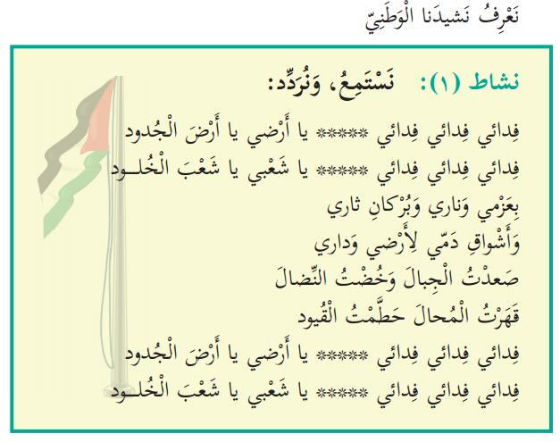
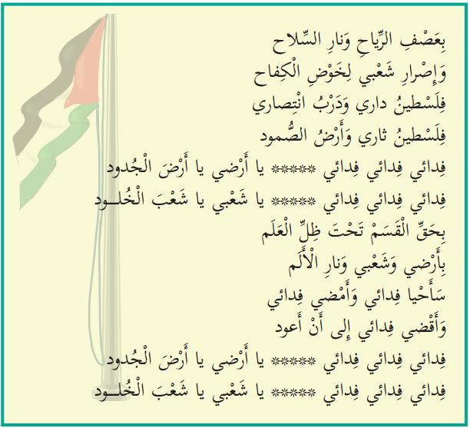
Expressions of violence in the Palestinian Authority’s national anthem taught in school:
"Let us know our national anthem:
Activity 1: We will listen and repeat:
Fidai*, fidai, fidai, O my land, O land of the forefathers
Fidai, fidai, fidai, O my people, O people of eternity
With my determination, my fire and the volcano of my revenge
And my blood's yearning to my land and my home
I have climbed mountains and embarked on a struggle
I defeated the impossible and shattered the shackles
Fidai, fidai, fidai, O my land, O land of the forefathers
Fidai, fidai, fidai, O my people, O people of eternity
In the winds' storm and the weapon's fire
And my people's determination to carry on the struggle
Palestine is my home and the road to my victory
Palestine is my revenge and the land of steadfastness
Fidai, fidai, fidai, O my land, O land of the forefathers
Fidai, fidai, fidai, O my people, O people of eternity
By the oath under the flag's shadow
By my people's determination, and by the pain's fire
I shall live as a fidai and I shall continue as a fidai
And I shall die as a fidai until I return
Fidai, fidai, fidai, O my land, O land of the forefathers
Fidai, fidai, fidai, O my people, O people of eternity“
(National and Social Upbringing, Grade 3, Part 1 (2020) pp. 16-17. Emphasis added)
*Fidai – a self-sacrificing person; this term is used nowadays to denote the members of the Palestinian terrorist organizations.

Slide 6
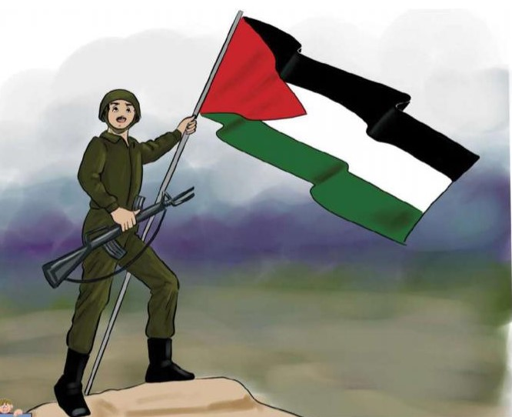
The liberation struggle as depicted to grade 1 students: (Our Beautiful Language, Grade 1, Part 2 (2020) p. 83)

Slide 7
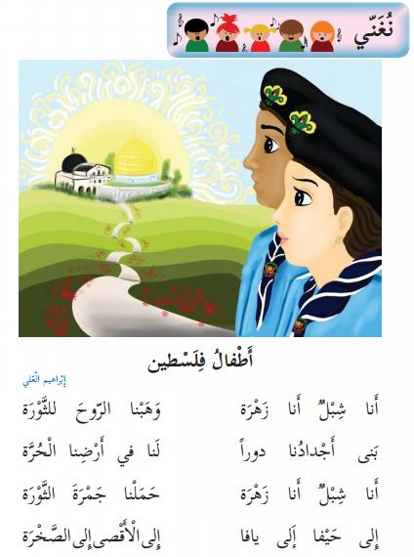
The liberation of Palestine does not end at the 1967 lines. Haifa and Jaffa, within Israel’s pre-1967 borders, are included too: “Let us sing: Children of Palestine I am a lion cub*; I am a flower** We have given the soul to the Revolution*** Our forefathers built houses For us in our free country [in the past] I am a lion cub; I am a flower We have carried the ember of the Revolution To Haifa, to Jaffa to Al-Aqsa [Mosque], to the [Dome of the] Rock” *Lion cub – Male member of the Fatah youth movement **Flower – Female member of that movement ***Revolution – Fatah terrorist activity that began on 1.1.1965 (Our Beautiful Language, Grade 2, Part 1 (2020) p. 44. Emphasis added)

Slide 8
Jaffa is considered a Palestinian occupied city that should be liberated, as said in a language exercise: “2. It would be appropriate for Jaffa to return to our bosom.” (Arabic Language, Grade 8, Part 2 (2019) p. 102)

Slide 9
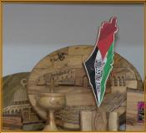
There is no room for Israel in free Palestine: "FREE PALESTINE" (Sciences and Life, Grade 3, Part 1 (2020) p. 65)

Slide 10
The ending of a story about a refugee’s reminiscences emphasizes that the perceived return of the 1948 refugees will be an integral part of the full liberation of Palestine. They will not return to live in peace with their Israeli neighbors, as decreed by the UN 194 resolution of 1948: “We shall return; we shall return with the soaring eagles; we shall return with the fiercely blowing wind; we shall return to the vineyard and the olive trees; we shall return in order to hoist the flag of Palestine next to the anemone flower on our green hills.” (Arabic Language, Grade 5, Part 1 (2020) p. 84)

Slide 11
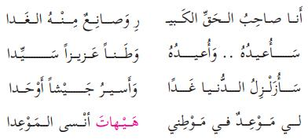
Part of a poem titled “A Refugee’s Cry” stresses the same point: “I am the owner of the great right and the one who makes the morrow out of it I shall retrieve it; I shall retrieve it as a precious and sovereign homeland I shall shake the world tomorrow and shall march as one army I have an appointment in my homeland and it is impossible that I forget the appointment” (Arabic Language, Grade 5, Part 1 (2020) p. 86, and see among the accompanying questions: “The poet has determined the form of the return. Let us clarify it, as it appears in the poem.”)

Slide 12
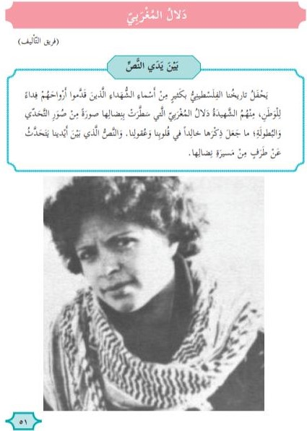
Terror is part and parcel of the liberation struggle. Following is the first page of a 4-page lesson that exalts the female commander of the terrorist attack on a civilian bus on Israel’s Coastal Highway in 1978 in which more than thirty Israelis – men, women and children were murdered: “Dalal al-Mughrabi ([by] the writing team) In front of the text: Our Palestinian history is replete with many names of martyrs who have given their soul in sacrifice for the homeland. Among them [is] the martyr Dalal al-Mughrabi who has illustrated with her struggle a picture of challenging and bravery that have made her memory eternal in our hearts and minds. The text in front of us speaks of one aspect of her struggle path.” (Arabic Language, Grade 5, Part 2 (2020) p. 51)

Slide 13
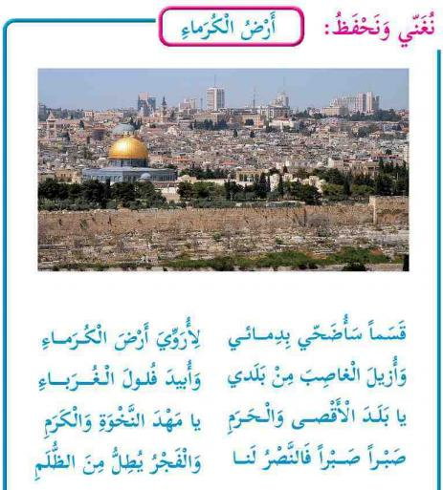
A rare explicit reference to the question: what should be done with the surviving Jews after the liberation of Palestine: “We will sing and learn by heart: The Land of the Noble Ones I swear, I shall sacrifice my blood in order to water the land of the noble ones And to remove the usurper [Israel] from my country and to exterminate the foreigners’ defeated remnants O land of Al-Aqsa and the sanctuary O cradle of dignity and nobleness Patience, patience, for victory is ours and dawn is peeping from the darkness (Our Beautiful Language, Grade 3, Part 2 (2019) p. 66. Emphasis added) This song is sung in class: https://www.youtube.com/watch?v=Yan7tf3E6UU Important Note: In the 2020 edition of this PA textbook, this poem has been replaced by another one, with no extermination expressions. Do our efforts begin to bear fruit?

Slide 14
Conclusion
The Palestinian Authority textbooks used by UNRWA in its schools de-legitimize the existence of the State of Israel, a full member-state of the United Nations Organization, and the very presence in the country of its 6 million Jewish citizens, whose history and holy places there are denied.
The PA schoolbooks used by UNRWA demonize both Israel and the Jews, to the point of sheer anti-Semitism.
These very books never advocate a peaceful solution to the present Israeli-Palestinian conflict. Instead, they call for a violent struggle for liberation which is not limited by the 1967 lines and in which terror plays a central part.
Being a UN agency, UNRWA is committed to neutrality and peace, but its use of such schoolbooks sharply contradicts that commitment and makes UNRWA a full accomplice in the PA anti-Semitic indoctrination. Moreover, UNRWA betrays its sacred obligation towards the wellbeing of the Palestinian children and youths under its care, by preparing them for war against their Israeli counterparts.
This kind of “education” should stop immediately and the donor states should have a say in this matter, the sooner the better.

