Slide 1
Jews, Israel and Peace in Textbooks Used in UNRWA Schools in the West Bank and Gaza
By
Dr. Arnon Groiss
(July 2022)

Slide 2
Introduction
The Palestinian Authority’s schoolbooks, including those ones in UNRWA use, feature 3 fundamentals in the context of the conflict:
De-legitimization of Israel’s existence and the Jews’ presence in the country, including the denial of their history and the existence of any Jewish holy places there.
Demonization of both Israel and Jews, also religiously – with serious implications regarding the Jews’ image in the eyes of children who come from a traditional society.
The absence of call for peace with Israel. Instead, there is a call for a violent struggle for the liberation of the whole country, including pre-1967 Israel. This struggle is given a religious color and terror is made an integral part thereof, with the accompanying meaning of encouraging the murder of Jews.

Slide 3
De-legitimization

Slide 4
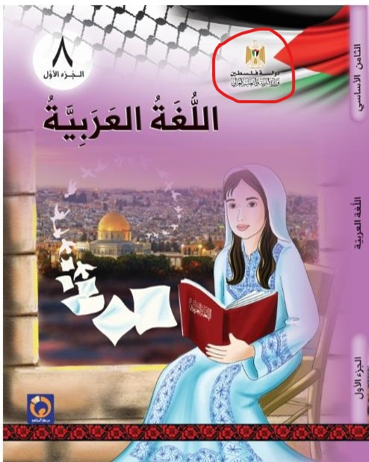
The Palestinian Authority describes itself as “the State of Palestine” and considers itself a full state under foreign occupation the boundaries of which are not restricted to the 1967 lines. The name “the State of Palestine”, not “the Palestinian Authority”, appears on the cover of all schoolbooks. The example here – the cover of an Arabic language textbook for grade 8, part 1, published in 2020 – shows the PA emblem with the inscription underneath saying “the State of Palestine; Ministry of Education and Higher Education” (marked by a red circle on top right).

Slide 5
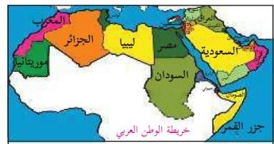
“[Lesson] 2: Palestine is Arab and Muslim” The lesson presents a map titled “Map of the Arab Homeland” in which the whole country is painted red, with the name “Palestine” appearing next to it and the Palestinian flag is drawn above. (National and Social Upbringing, Grade 4, part 1 (2020) p. 8)

Slide 6
A map titled “Map of Palestine and the Levant” in which Palestine appears as a sovereign state, instead of the State of Israel, next to Lebanon, Syria and Jordan. (Geography and Modern and Contemporary History of Palestine, Grade 10, Part 1 (2020) p. 8)

Slide 7
The term “Zionist occupation” usually replaces the name “Israel” in the schoolbooks”: “…The Arab armies withdrew from Palestine and the Rhodes Armistice was signed in 1949 separately between the Zionist occupation and each of Jordan, Egypt, Syria and Lebanon…” (Geography and Modern and Contemporary History of Palestine, Grade 10, Part 2 (2020) p. 7)

Slide 8
The term “the territories occupied in 1948” replaces in the schoolbooks the expression “Israeli [pre-1967] territory”: “The following chart clarifies the numbers of Palestinians in the year 2015 according to the Palestinian Statistics Center: Region Number of Inhabitants The West Bank and the Gaza Strip 4,750,000 Inside the territories occupied in 1948 1,470,000 In the Arab states 5,460,000 In the foreign states 685,000 I will organize the regions where the Palestinians are found in a descending order according to the numbers of inhabitants: [4 empty squares]” (Mathematics, Grade 4, Part 1 (2020) p. 22. Emphasis added)

Slide 9
Israel and its inhabitants are considered a foreign colonialist entity: “I will compare the tragedy of the Indians, America’s original inhabitants, to the tragedy of the Palestinian people.” (Social Studies, Grade 8, Part 2 (2020) p. 34)

Slide 10
Denial of the country’s Jewish history: “…[The occupier] has built for himself an artificial entity that derives its identity and the legitimacy of its existence from fairy tales, legends and phantasies and tried in various methods and ways to create living material evidence for these legends, or archaeological [and] architectural proofs that would attest to their correctness and authenticity, but in vain.” (Arabic Language – the Academic Path, Grade 10, Part 2 (2020) p. 68)

Slide 11
Denial of the existence of Jewish holy places in the country, including the Wailing Wall in Jerusalem (note that the photograph is cut in a way that “hides” the Jews who pray there): “Al-Buraq Wall Illumination: The Al-Buraq Wall is thus named after Al-Buraq [the divine beast] that carried the Messenger [Muhammad] in the Nocturnal Journey [from the Mecca mosque to Al-Aqsa Mosque in Jerusalem according to Muslim belief]. Al-Buraq Wall is part of the western wall of Al-Aqsa Mosque. Al-Aqsa Mosque, including the wall, is a Palestinian land and the Muslims’ exclusive right.” (Islamic Education, Grade 5, Part 1 (2020) p. 63)

Slide 12
Having been considered foreign settlers, the Jews in the country are not counted among its inhabitants and the cities they built, including Tel Aviv, are absent from the maps featured in textbooks that are used in UNRWA schools. The map shown here, titled “Map of Palestine”, does not show these cities at all, except for Eilat that appears under the Arabic name of the desolate place where it was later built – “Umm al-Rashrash”. (Social Studies, Grade 6, Part 1 (2020) p. 6)

Slide 13
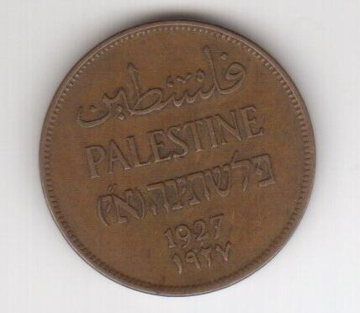
Hebrew – the language of the Jews in the country – is erased, literally, from a British Mandate coin reproduced in a mathematics textbook: (Mathematics, Grade 6, Part 2 (2020) p. 65, and see the original coin on the left)

Slide 14
The Jews’ historical and religious ties to Jerusalem are completely ignored: “Jerusalem is an Arab city built by our Arab ancestors thousands of years ago. Jerusalem is a holy city among Muslims and Christians.” (National and Social Upbringing, Grade 3, Part 1 (2020) p. 29)

Slide 15
A short description of Jerusalem’s history with a huge 1,000 year-gap between the Jebusites and the Romans, namely, the Jewish historical period. The name “Jerusalem” itself, so common worldwide, is also ignored: “The city of Jerusalem was known by the name Jebus, after the Arab Jebusites who built it 5,000 years ago. When the Romans occupied it, they called it by the name Aelia. Later, it came to be known as Al-Quds and Bayt al-Maqdis, after the Muslims conquered it at the hands of [Caliph] Umar Bin al-Khattab in the year 637…” (Geography and Modern and Contemporary History of Palestine, Grade 10, Part 1 (2020) p. 43)

Slide 16
Demonization

Slide 17
Demonization of Israel by way of self-victimization. Following are excerpts from “a Letter by a Palestinian girl to children of the world”:
“Since I was born, they have murdered my childhood. They tore my doll into pieces and I have hidden it in my heart. Since I was born, the bullets’ whistle has pierced my ears, and blackness has covered everything around me…
…Why did they slaughter my childhood in front of me and murder the roses in the fields? Why did they kill the butterflies in our gardens and scare the birds away? Why did they hide the sun, spread darkness and block the roads?”
(Arabic Language, Grade 8, Part 1 (2020) pp. 47, 48, respectively)

Slide 18
Zionists are demonized and accused of genocidal intentions towards the Palestinians: “1. The Zionists have founded their entity on terror, extermination and colonialism. Let us explain that.” (Arabic Language – Academic Path, Grade 10, Part 2 (2020) p. 28)

Slide 19
Jews are demonized as infidels and as the Devil’s aides: “Where are the horsemen [who will ride] to Al-Aqsa [Mosque] to liberate it From the grip of infidelity, from the Devil’s aides?” (Arabic Language, Grade 7, Part 1 (2020) p. 67)

Slide 20
Jews are demonized as well outside the context of the conflict, as enemies of Prophet Muhammad and Islam in its early years, with attributed traits such as treachery and hostility, thus making them eternal enemies of Muslims today: “But the Jews [in the city of Medina] did not respect the treaty [they had concluded with Muhammad] and resorted to all sorts of treachery, betrayal and hostility, which forced the Muslims to fight them.” (Islamic Education, Grade 7, Part 1 (2020) p. 52)

Slide 21
Moreover, Jews are portrayed as enemies of all God’s prophets and, by extension, enemies of God Himself. The following is the first out of several lessons to be learned from the chapter about Jesus Christ (who is considered one of God’s prophets in Islam): “1. Revealing the Children of Israel’s nature and their hostility to the prophets.” (Islamic Education, Grade 9, Part 2 (2020) p. 21)

Slide 22
The next slide has been taken from a teacher’s guide. The teachers’ guides, printed in 2018, clearly show the indoctrination methods used, including the intensification of Jew-hatred. Here we can see an example of a student evaluation sheet covering three items of which the last one (marked in red) talks about the reasons for massacres perpetrated by Jews against Arabs in 1948. The highest grade is given to the student who connected the massacres to the Jewish religious thought! A lesser grade was given to the student who connected the massacres to the Zionist thought. The “unsatisfactory” grade was given to the student who wrote the reasons for the massacres but did not connect them to the Jewish or Zionist thought!

Slide 23
“Chart 2: Matrix of Accomplishment Levels [please read from right item to left] Unsatisfactory (1) Satisfactory (2) Good (3) Subject Tested/Level of Accomplishment … … … … … … … … [The student] defined [The student] connected [The student] connected Clarification of the Zionist gangs’ goal of correctly the Zionist correctly the Zionist gangs’ accurately the perpetration perpetrating massacres gangs’ goal of perpetrating thought to their perpetration of Zionist massacres to massacres [but did not of massacres Jewish religious thought connect that to Jewish or Zionist thought!] (Teacher’s Guide, Geography and Modern and Contemporary History of Palestine, Grade 10 (2018) p. 164)

Slide 24
Peace?

Slide 25
The only reference in the schoolbooks to the issue of peace with Israel is found in Arafat’s letter to Rabin prior to the signing of the Oslo Accords in 1993, given in a history textbook. But peace and co-existence with Israel are never advocated in any schoolbook throughout the entire curriculum. Following are the relevant excerpts from Arafat’s letter: “…The Palestine Liberation Organization recognizes the State of Israel’s right to live in peace and security. The Organization accepts the UN Security Council’s resolutions Nos. 242 and 338. The Organization commits itself to the peace process in the Middle East and to the peaceful resolution of the conflict between the two parties and declares that all the political issues related to the permanent situation will be solved through negotiations. Accordingly, the Organization denounces the use of terror and other violent actions…” (Geography and Modern and Contemporary History of Palestine, Grade 10, Part 2 (2020) p. 77)

Slide 26
Instead of peace advocacy, the PA schoolbooks in UNRWA use call for a violent struggle for the liberation of Palestine in its entirety, as we shall see in the following slides. A hint of the war indoctrination is given in the Palestinian Authority’s national anthem that is learned in class:

Slide 27
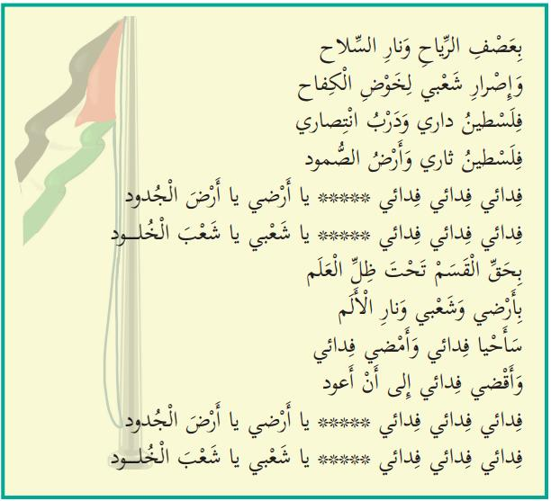
Expressions of violence in the Palestinian Authority’s national anthem taught in school:
"Let us know our national anthem:
Activity 1: We will listen and repeat:
Fidai*, fidai, fidai, O my land, O land of the forefathers
Fidai, fidai, fidai, O my people, O people of eternity
With my determination, my fire and the volcano of my revenge
And my blood's yearning to my land and my home
I have climbed mountains and embarked on a struggle
I defeated the impossible and shattered the shackles
Fidai, fidai, fidai, O my land, O land of the forefathers
Fidai, fidai, fidai, O my people, O people of eternity
In the winds' storm and the weapon's fire
And my people's determination to carry on the struggle
Palestine is my home and the road to my victory
Palestine is my revenge and the land of steadfastness
Fidai, fidai, fidai, O my land, O land of the forefathers
Fidai, fidai, fidai, O my people, O people of eternity
By the oath under the flag's shadow
By my people's determination, and by the pain's fire
I shall live as a fidai and I shall continue as a fidai
And I shall die as a fidai until I return
Fidai, fidai, fidai, O my land, O land of the forefathers
Fidai, fidai, fidai, O my people, O people of eternity“
(National and Social Upbringing, Grade 3, Part 1 (2020) pp. 16-17. Emphasis added)
*Fidai – a self-sacrificing person; this term is used nowadays to denote the members of the Palestinian terrorist organizations.

Slide 28
The liberation struggle as depicted to grade 1 students: (Our Beautiful Language, Grade 1, Part 2 (2020) p. 83)

Slide 29
This national struggle is given a religious character by using the traditional Islamic term “Jihad”: “God urges the believers to Jihad and its financing and warns them against their being occupied with worldly life [matters] instead of [performing] the Jihad and financing it, for worldly life deceives the ones who are occupied with that and the believer should obey the orders of God and His Messenger [Muhammad] regarding that and refrain from disobeying Him, so that he would achieve the reward and credit on the Day of Resurrection.” (Islamic Education, Grade 9, Part 1 (2020) p. 27)

Slide 30
PA textbooks in UNRWA’s schools also use the Islamic traditional ideal of martyrdom (Shahadah). The martyr (Shahid) gains, according to Islamic belief, much reward in Afterlife, including his marriage to 72 virgins. In the following example, taken from a teacher’s guide in the subject of art, this particular item is included among drawing options for the students (marked in red): “Alternative suggestions: … 3. Drawing a Shahid’s wedding scene …” (Teacher’s guide, Art Education, Grade 6 (2017 – latest edition so far) p. 54)

Slide 31
The liberation of Palestine does not end at the 1967 lines. Haifa and Jaffa, two cities inside Israel’s pre-1967 territory, are included too: “Let us sing: Children of Palestine I am a lion cub*; I am a flower** We have given the soul to the Revolution*** Our forefathers built houses For us in our free country [in the past] I am a lion cub; I am a flower We have carried the ember of the Revolution To Haifa, to Jaffa to Al-Aqsa [Mosque], to the [Dome of the] Rock” *Lion cub – Male member of the Fatah youth movement **Flower – Female member of that movement ***Revolution – Fatah terrorist activity that began on 1.1.1965 (Our Beautiful Language, Grade 2, Part 1 (2020) p. 44. Emphasis added)

Slide 32
Jaffa is considered a Palestinian occupied city that should be liberated, as said in a language exercise: “2. It would be appropriate for Jaffa to return to our bosom.” (Arabic Language, Grade 8, Part 2 (2019) p. 102)

Slide 33
There is no room for Israel in free Palestine: "FREE PALESTINE" (Sciences and Life, Grade 3, Part 1 (2020) p. 65)

Slide 34
the return of the 1948 refugees will be an integral part of the violent struggle for the full liberation of Palestine, in clear contrast to the UN 194 resolution that calls for the return of those refugees who would like to live in peace with their neighbors. The ending of a story about a refugee’s reminiscences emphasizes that: “We shall return; we shall return with the soaring eagles; we shall return with the fiercely blowing wind; we shall return to the vineyard and the olive trees; we shall return in order to hoist the flag of Palestine next to the anemone flower on our green hills.” (Arabic Language, Grade 5, Part 1 (2020) p. 84)

Slide 35
Part of a poem titled “A Refugee’s Cry” stresses the same point: “I am the owner of the great right and the one who makes the morrow out of it I shall retrieve it; I shall retrieve it as a precious and sovereign homeland I shall shake the world tomorrow and shall march as one army I have an appointment in my homeland and it is impossible that I forget the appointment” (Arabic Language, Grade 5, Part 1 (2020) p. 86, and see among the accompanying questions: “The poet has determined the form of the return. Let us clarify it, as it appears in the poem.”)

Slide 36
Terror is part and parcel of the liberation struggle. Following is the first page of a 4-page lesson that exalts the female commander of the terrorist attack on a civilian bus on Israel’s Coastal Highway in 1978 in which more than thirty Israelis – men, women and children were murdered: “Dalal al-Mughrabi ([by] the writing team) In front of the text: Our Palestinian history is replete with many names of martyrs who have given their soul in sacrifice for the homeland. Among them [is] the martyr Dalal al-Mughrabi who has illustrated with her struggle a picture of challenging and bravery that have made her memory eternal in our hearts and minds. The text in front of us speaks of one aspect of her struggle path.” (Arabic Language, Grade 5, Part 2 (2020) p. 51)

Slide 37
A rare clear message answering the question: “What should be done with the Jews who will survive after the liberation of Palestine?” The answer: Extermination! “We will sing and learn by heart: The Land of the Noble Ones I swear! I shall sacrifice my blood in order to water the land of the noble ones And remove the usurper [Israel] from my country and exterminate the defeated remnants of the foreigners [in Arabic: ubid fulul al-ghuraba’] O, land of Al-Aqsa and the holy site [haram], O, cradle of pride and nobility Patience, patience, for victory is ours and dawn is peeping out of darkness” (Our Beautiful Language, Grade 3, Part 2 (2019) p. 66. Emphasis added) This poem is sung in class (and see the next slide) Note This poem has been replaced in the 2020 edition of this textbook by another one with no expressions of extermination, probably as a result of our criticism. But have the students stopped singing it in class?

Slide 38
Screenshot of the beginning of a YouTube clip by “the Group of Palestine’s Teachers”. The inscription here says: “The song of ‘The Land of the Noble Ones’, Grade 3 Elementary, Music by Rabi’ Abu Bakr” The link to the clip: https://www.youtube.com/watch?v=Yan7tf3E6UU And if it does not open, try this one: https://vimeo.com/390503872

Slide 39
Conclusion
The Palestinian Authority textbooks used by UNRWA in its schools de-legitimize the existence of the State of Israel, a full member-state of the United Nations Organization, and the very presence in the country of its 6 million Jewish citizens, whose history and holy places there are denied.
The PA schoolbooks used by UNRWA demonize both Israel and the Jews, to the point of sheer anti-Semitism.
These very books never advocate a peaceful solution to the present Israeli-Palestinian conflict. Instead, they call for a violent struggle for liberation which is not limited by the 1967 lines and in which terror plays a central part.
Being a UN agency, UNRWA is committed to neutrality and peace, but its use of such schoolbooks sharply contradicts that commitment and makes UNRWA a full accomplice in the PA anti-Semitic indoctrination. Moreover, UNRWA betrays its sacred obligation towards the wellbeing of the Palestinian children and youths under its care, by preparing them for war against their Israeli counterparts.
This kind of “education” should stop immediately and the donor states should have a say in this matter, the sooner the better.

